Slide 1


Teaching Compound Measures using
Ratio & Proportion
Kathryn Darwin
Deputy Subject Leader – Maths
Manor Croft Academy, Dewsbury
darwink@manorcroft.org.uk
@Arithmaticks

Slide 2
Session Outline
The problem with triangles
The problem with the concept
Speed Calculations:
  Prerequisites
  Bar Models
  Ratio tables/notation
  Unit Changes
Density & Pressure
Other topics

Slide 3
The Problem with Triangles
D
M
S
T
D
V
F
P
A
Notes:
What if you remember the wrong order!?
Feels like magic
- No conceptual understanding of the links between variables

Slide 4
The Problem with Triangles
D
John drives 60 miles in 40 minutes.
What is his average speed in mph?
S
T
Notes:
2 ways to go wrong
Issues with converting 40 mins into decimal form
Use 40 mins but then miles/min and mess up the conversion ****

Slide 5

The problem with the concept…

Slide 6
Speed Calculations - Prerequisites
Multiplicative relationships & direct proportion
Unit conversions
  Time – Hours/Min/Seconds
    Multiples and factors of 60
    Multiples of the factors of 60!
  Distance
    Metric
    Imperial, given conversions
Notes:
Some obvious things we need to know here but my favourite thing is that these are also proportional relationships and we can apply the same ideas to these too!

Slide 7
Speed Calculations - Bar Models
Katie drives 80 miles in 2 hours.
What is her average speed in mph?

Slide 8
Speed Calculations - Bar Models
John drives 60 miles in 40 minutes.
What is his average speed in mph?

Slide 9
Speed Calculations - Bar Models
A bus travels 105 miles in 1 and a half hours.
What is the average speed in mph?

Slide 10
Speed Calculations - Ratio (Tables)
The key is to understand that speed is a UNIT RATIO.
The unit is the unit of time.
E.g. We write:
  20mph as 20 miles :1 hour
  50km/hour as 50km : 1 hour
  4m/s as 4m : 1 second
  1 mile/min as 1 mile : 1 minute

Slide 11
Speed Calculations - Ratio (Tables)
Get students to PLAY with it first…
What else is true?
20mph

Slide 12
Speed Calculations - Ratio (Tables)
Katie drives 80 miles in 2 hours.
What is her average speed in mph?

Slide 13
Speed Calculations – Ratio (Tables)
John drives 60 miles in 40 minutes.
What is his average speed in mph?

Slide 14
Speed Calculations - Ratio (Tables)
A bus travels 105 miles in 1 and a half hours.
What is the average speed in mph?

Slide 15
Speed Calculations - Ratio (Tables)
A taxi travels at 45mph.
How far does it travel in 2 hours?
How far does it travel in 40 minutes?

Slide 16
Speed Calculations - Ratio (Tables)
A taxi travels at 45mph.
How long will it take to travel 15 miles?
How long will it take to travel 70 miles?

Slide 17
Speed Calculations - Unit Changes
Get students to PLAY with it first…
What else is true?
5m/sec

Slide 18
Speed Calculations - Ratio (Tables)
Write 15m/s in kilometres per hour

Slide 19
Speed Calculations - Ratio (Tables)
Write 360km/h in metres per second

Slide 20
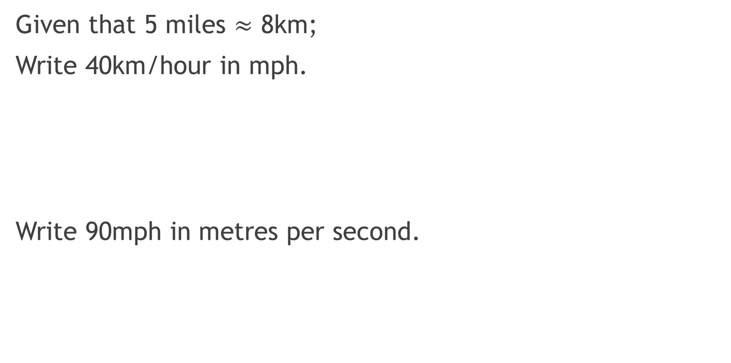
Speed Calculations - Ratio (Tables)
Given that 5 miles $≈$ 8km;
Write 40km/hour in mph.
Write 90mph in metres per second.

Slide 21
Density & Pressure
Pressure:
An object is placed on the ground and exerts a force of 3000N on an area of 4m²
What is the pressure in N/m²?
What is the pressure in N/cm²?

Slide 22
Density & Pressure
Density:
A piece of wood has a mass of 7g and a volume of 10cm³
What is the density in g/cm³?
What is the density in kg/m³?

Slide 23
Other Topics
Unit conversions
Gradient
Best buys
Similarity in 2D & 3D
  ‘LAV’ tables

Slide 24
Questions?

Slide 25
Teaching Compound Measures using
Ratio & Proportion
Kathryn Darwin
Deputy Subject Leader – Maths
Manor Croft Academy, Dewsbury
darwink@manorcroft.org.uk
@Arithmaticks

