Slide 1



“A lesson" is the wrong unit for learning
Associate Lead Teacher – Maths
Manor Croft Academy, Dewsbury
darwink@manorcroft.org.uk
@Arithmaticks

Slide 2
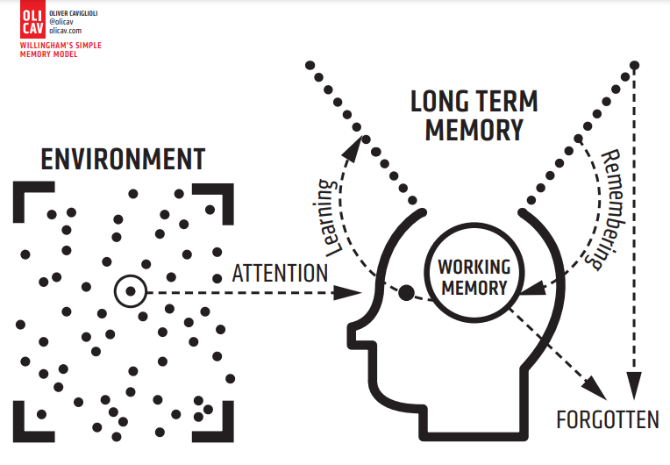
What is Learning?
“Learning is a change in long term memory"
Kirschner, Sweller and Clark (1998)
Notes:
First things first… what is learning?

Slide 3
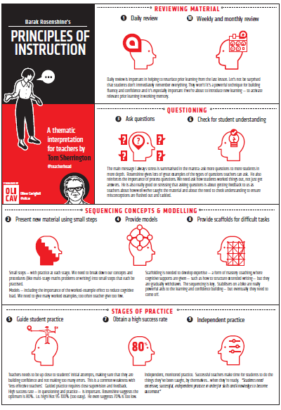

Notes:
Effective teaching been distilled in lots of ways… but Rosenshine is my favourite, simple but effective.
Tom Sherrington’s reworking puts Sequencing ideas at the centre.

Slide 4
The Role of the Teacher –
Prof Sam Twiselton
Task Managers
  What am I doing?
  How can I keep students busy in this block of time?
Curriculum Deliverers
  What have I “taught”?
  Have students remembered it?
  How do I teach this idea over time?
Concept/Skill Builders
  What have students LEARNED?
  What are the students thinking about?
  How can I help students to make connections?
Notes:
Lesson planning is a crucial learning point in your PGCE
Your role in the classroom starts at the top – what are you doing? and gradually you become a concept/skill builder
ECF accelerates this

Slide 5
Poor Proxies For Learning – Prof Rob Coe
Students are busy: lots of work is done (especially written)
Students are engaged, interested and motivated
Students are getting attention: feedback, explanations
Classroom is ordered, calm, under control
Curriculum has been 'covered' (i.e. presented to students)
(Some) students have supplied correct answers, even if they:
  have not really understood them
  could not reproduce them independently
  will have forgotten by next week (tomorrow?)
  already know it
Notes:
https://teacherhead.com/2021/07/12/poor-proxies-for-learning-powerful-insights-from-prof-coe/#:~:text=Poor%20Proxies%20is%20a%20powerful,the%20learning%20you're%20seeking.

Slide 6

Coherence
Small steps are easier to take.
Focusing on one key point each lesson allows for deep and sustainable learning.
Certain images, techniques and concepts are important pre-cursors to later ideas. Getting the sequencing of these right is an important skill in planning and teaching for mastery.
When introducing new ideas, it is important to make connections with earlier ones that have already been understood.
When something has been deeply understood and mastered, it can and should be used in the next steps of learning.
Notes:
https://teacherhead.com/2021/07/12/poor-proxies-for-learning-powerful-insights-from-prof-coe/#:~:text=Poor%20Proxies%20is%20a%20powerful,the%20learning%20you're%20seeking.

Slide 7
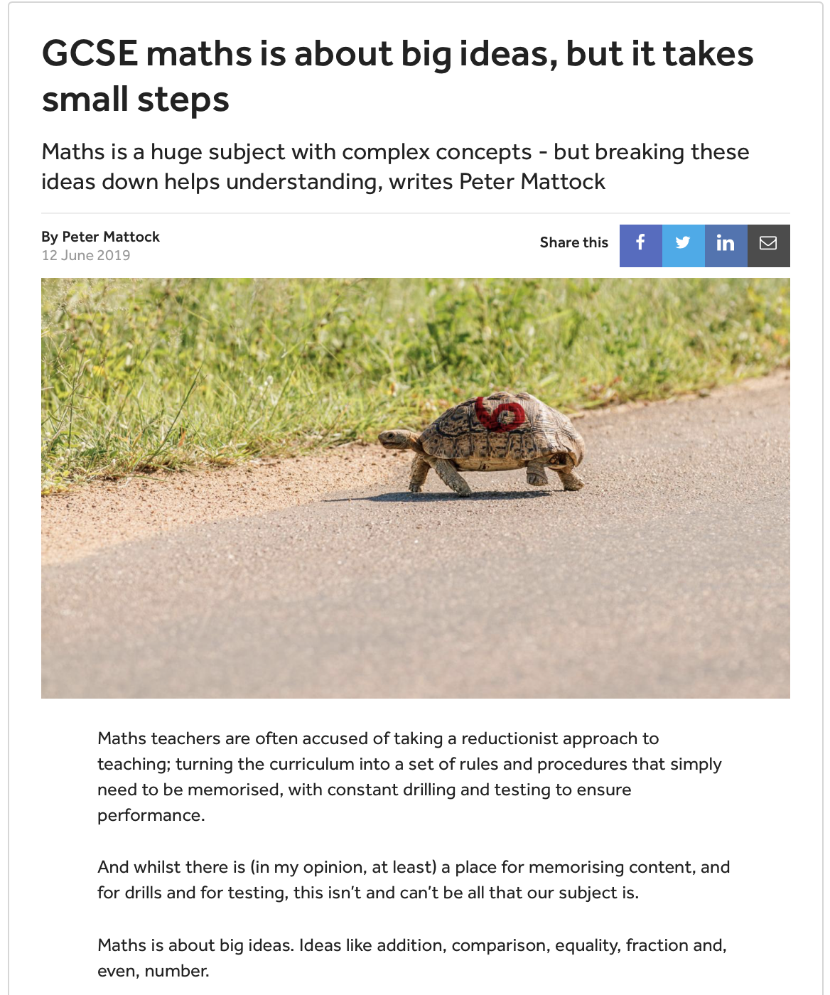
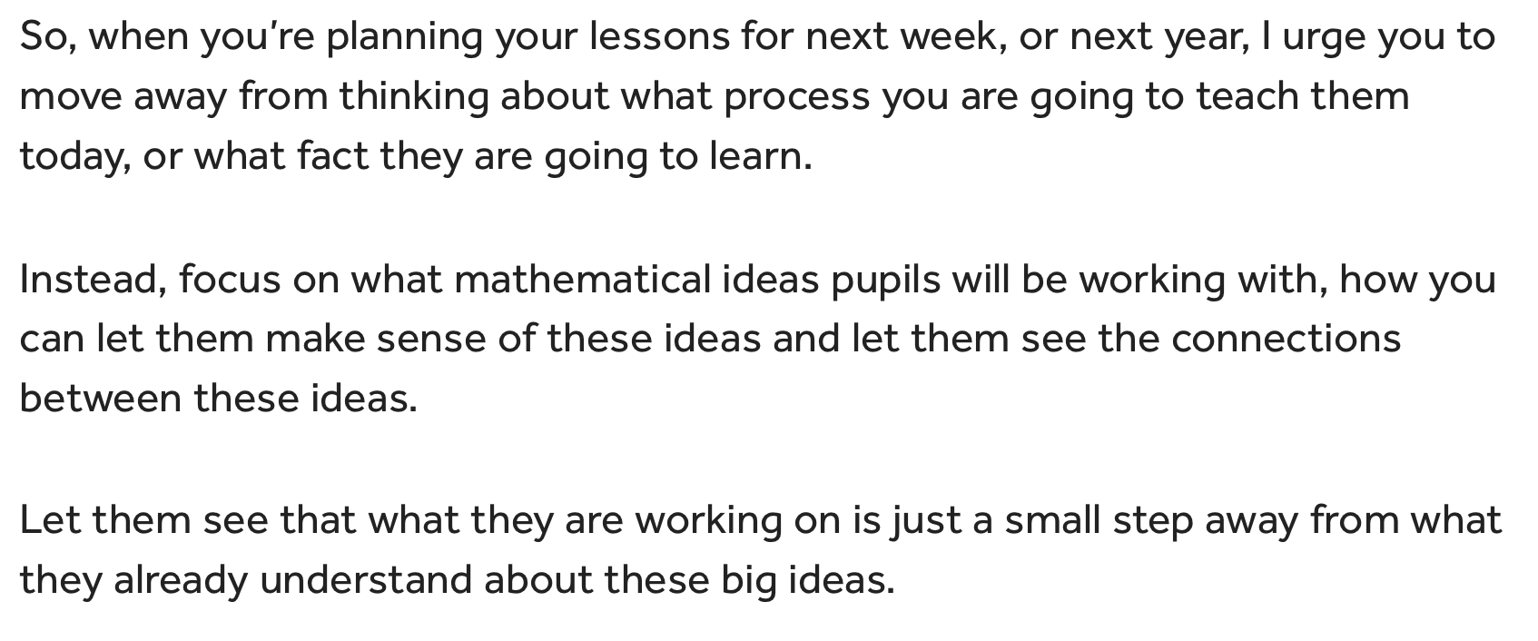
Coherence
Notes:
https://teacherhead.com/2021/07/12/poor-proxies-for-learning-powerful-insights-from-prof-coe/#:~:text=Poor%20Proxies%20is%20a%20powerful,the%20learning%20you're%20seeking.

Slide 8
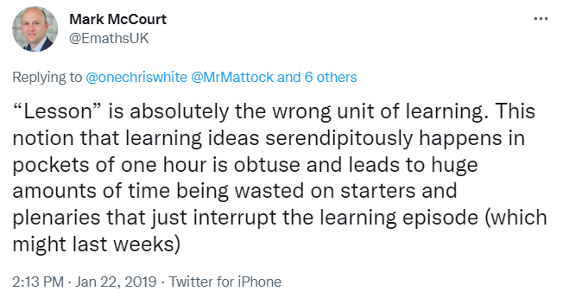
A Unit of Learning…
Notes:
Mark McCourt changed my thinking on what a unit of learning is… I cannot possibly put everything about fractions into an hour, or even split into neat 1 hour chunks.
V Interesting thread: https://twitter.com/emathsuk/status/1087714961919479808

Slide 9
Moving away from the ‘lesson’ as a unit of learning
A shift from ‘What can we/I do in this hour?” to
“How is best for my students to learn this concept?”
Allows you to see the big picture
  How does this idea fit into this unit?
  How does this unit/idea fit into the subject as a whole?
  What ideas have students learned before that support this one?
  What ideas are coming next that this will support?
Complex ideas require time and repetition for learning
“Don’t teach anything now that you will contradict later”
– Danni Quinn
Notes:
Move away from planning one hour… plan a suite of lessons
Move from task manager or deliverer to concept builder.

Slide 10
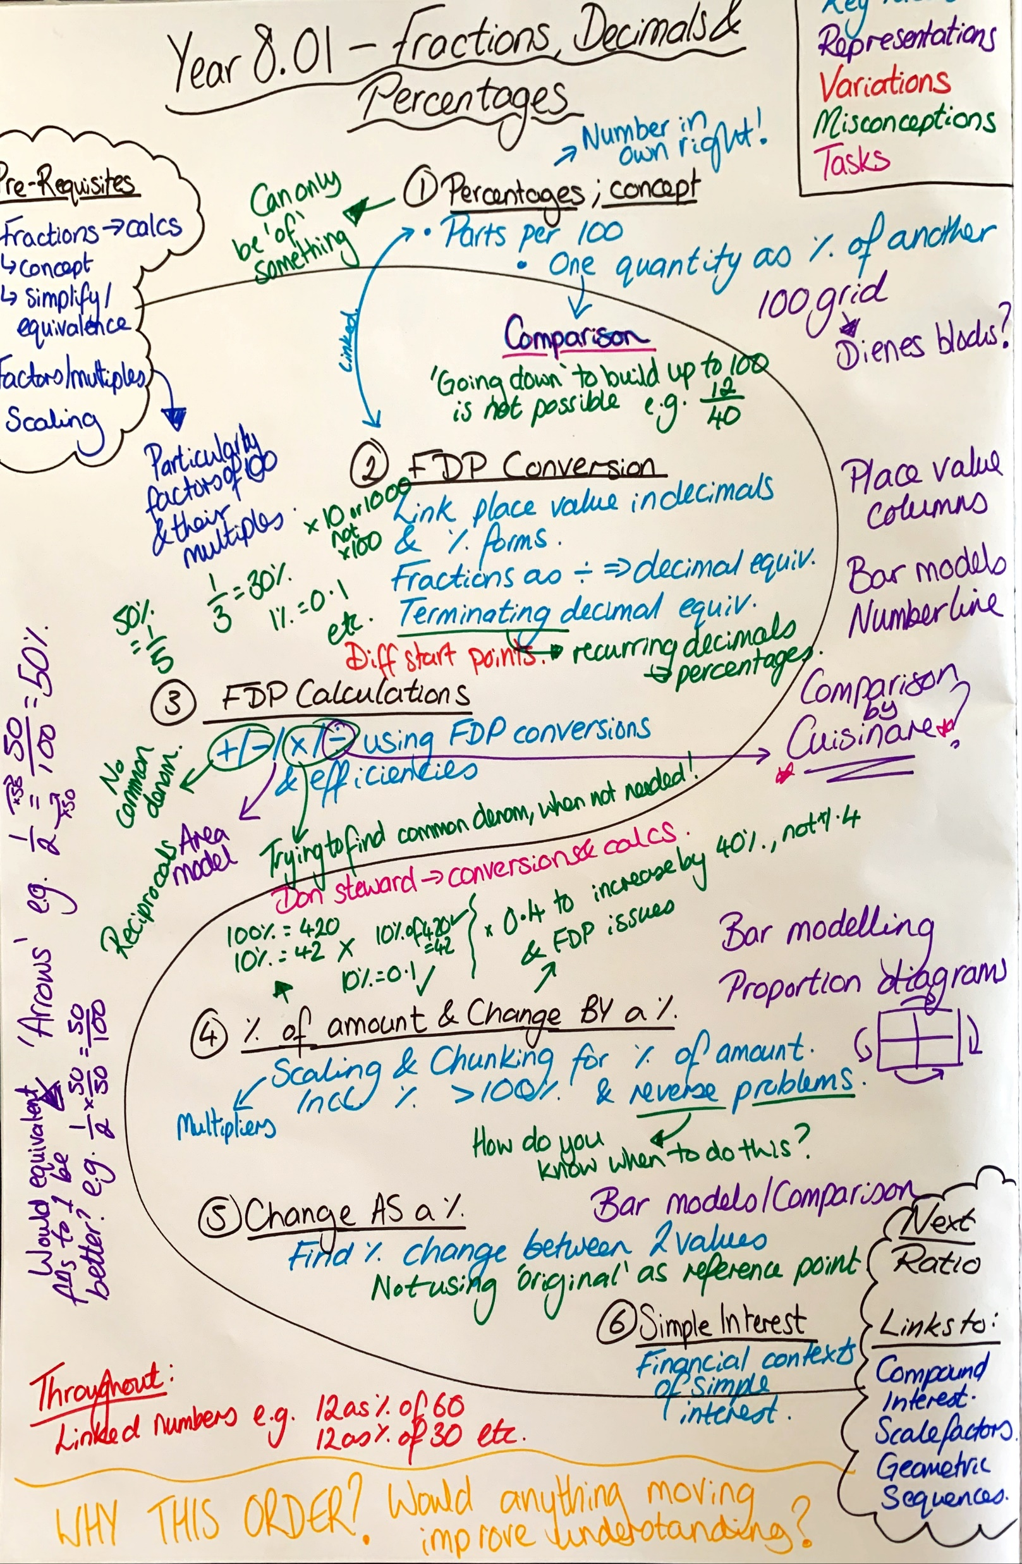
Seeing the Big Picture
S Planning
A method of medium term planning to enhance concept building and coherence across the unit and the Scheme of Work.
Considers:
Start and end points
Pre-requisites
Key Ideas – concepts & ‘doing’
Order of these Key Ideas
Representations
Variation
Misconceptions
Tasks and problems
Links to other topics
Notes:
Move away from planning one hour… plan a suite of lessons

Slide 11
“A lesson" is the wrong unit for learning
Associate Lead Teacher – Maths
Manor Croft Academy, Dewsbury
darwink@manorcroft.org.uk
@Arithmaticks

