Slide 1
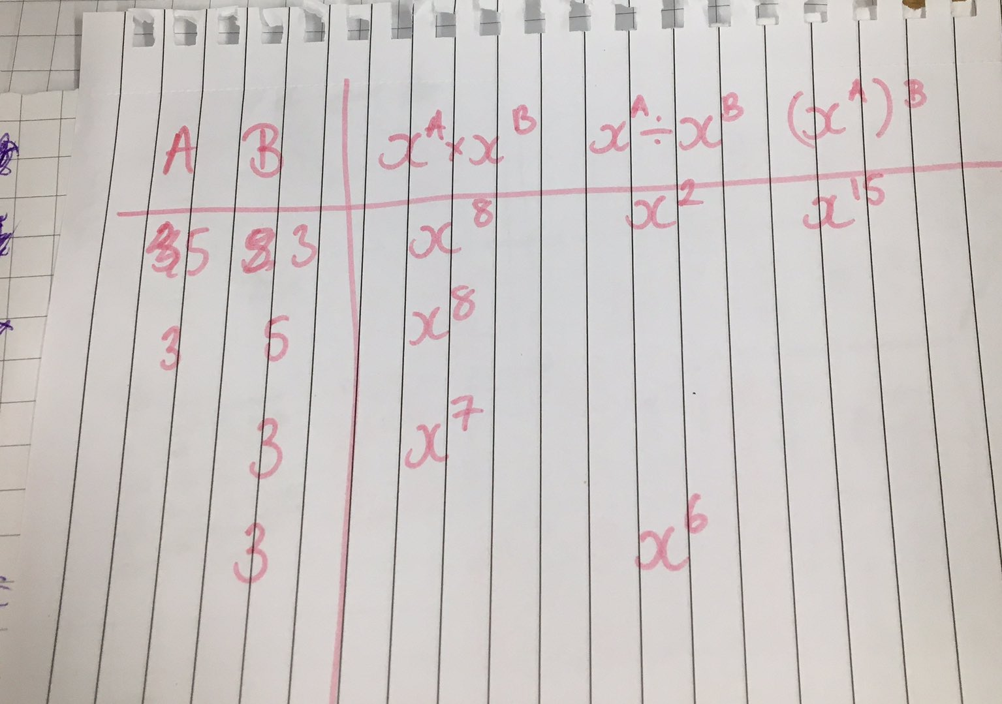

Slide 2
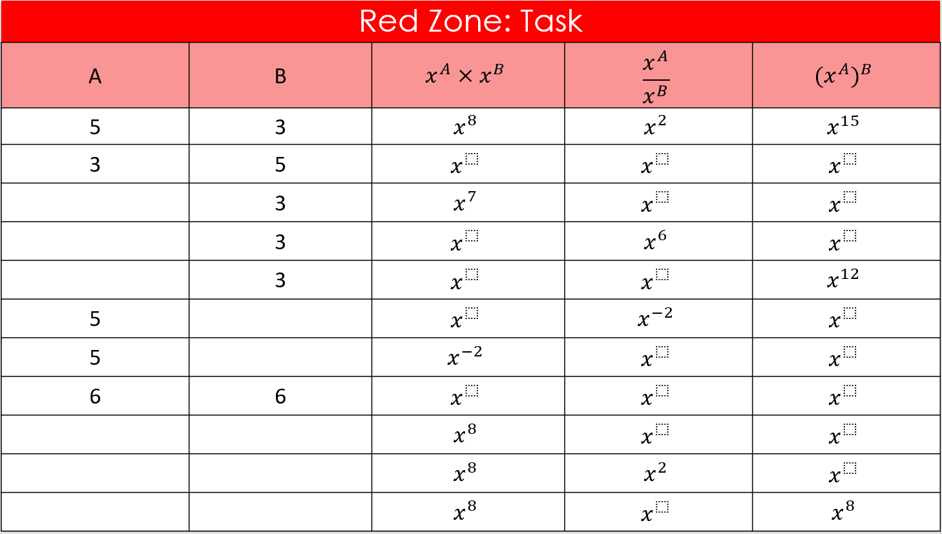

Slide 3
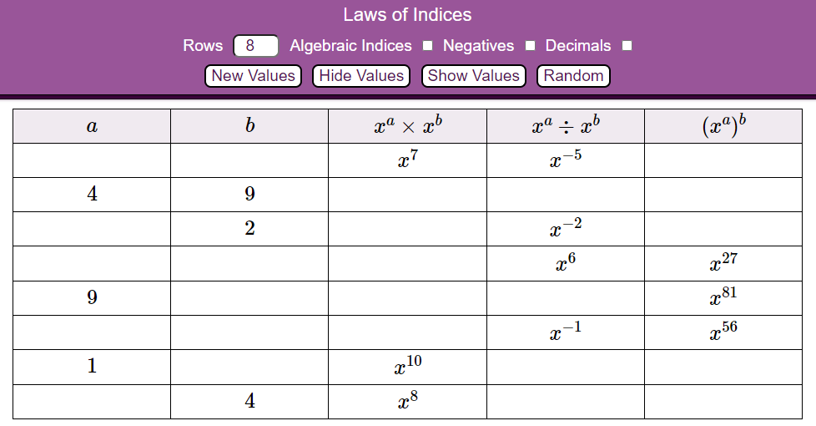
https://mathsbot.com/tables/indices

Slide 4
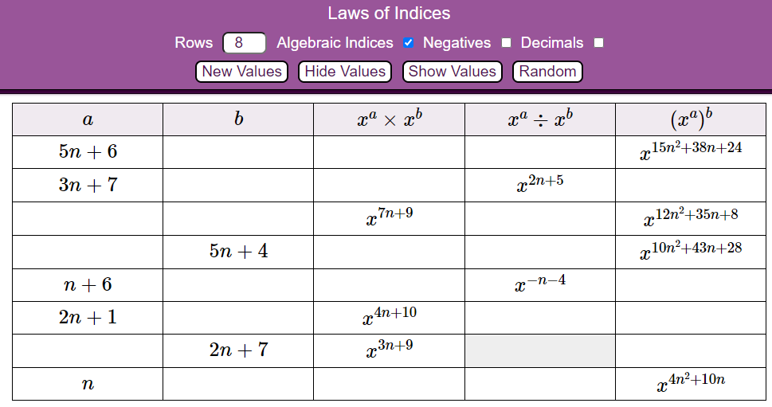
https://mathsbot.com/tables/indices

Slide 5
Red Zone: Task
Data | Ordered Data | Data Points | Smallest | Largest | Range | Median
1, 3, 4, 6, 7, 8, 10 | 1, 3, 4, 6, 7, 8, 10 | 7 | 1 | 10 | 9 | 6
5, 9, 2, 3, 8, 11, 7 |  | 7
5, 9, 2, 3, 11, 7 |  | 6
3, 4, 5, 7, 8, ___ |  | 6 | 3 |  | 7
6, 1, 7, ___, 5, 10, 4 |  | 7 | 1 | 10 |  | 5
6, ___, 7, 1, 3, 8, 1, 10 |  | 8 | 1 | 10 |  | 5
2, 5, 8, 9, 4, 8, 4, ___ |  | 8 |  | 9 | 7 | 5.5
 |  | 3 | 5 | 15 |  | 8
 |  | 5 | 5 | 15 |  | 8
 |  | 6 | 5 | 15 |  | 8
 |  | 3 |  | 12 | 6 | 8
 |  | 5 |  | 12 | 6 | 8
 |  | 6 |  | 12 | 6 | 8
 |  | 6 |  | 12 | 6 | 7

Slide 6
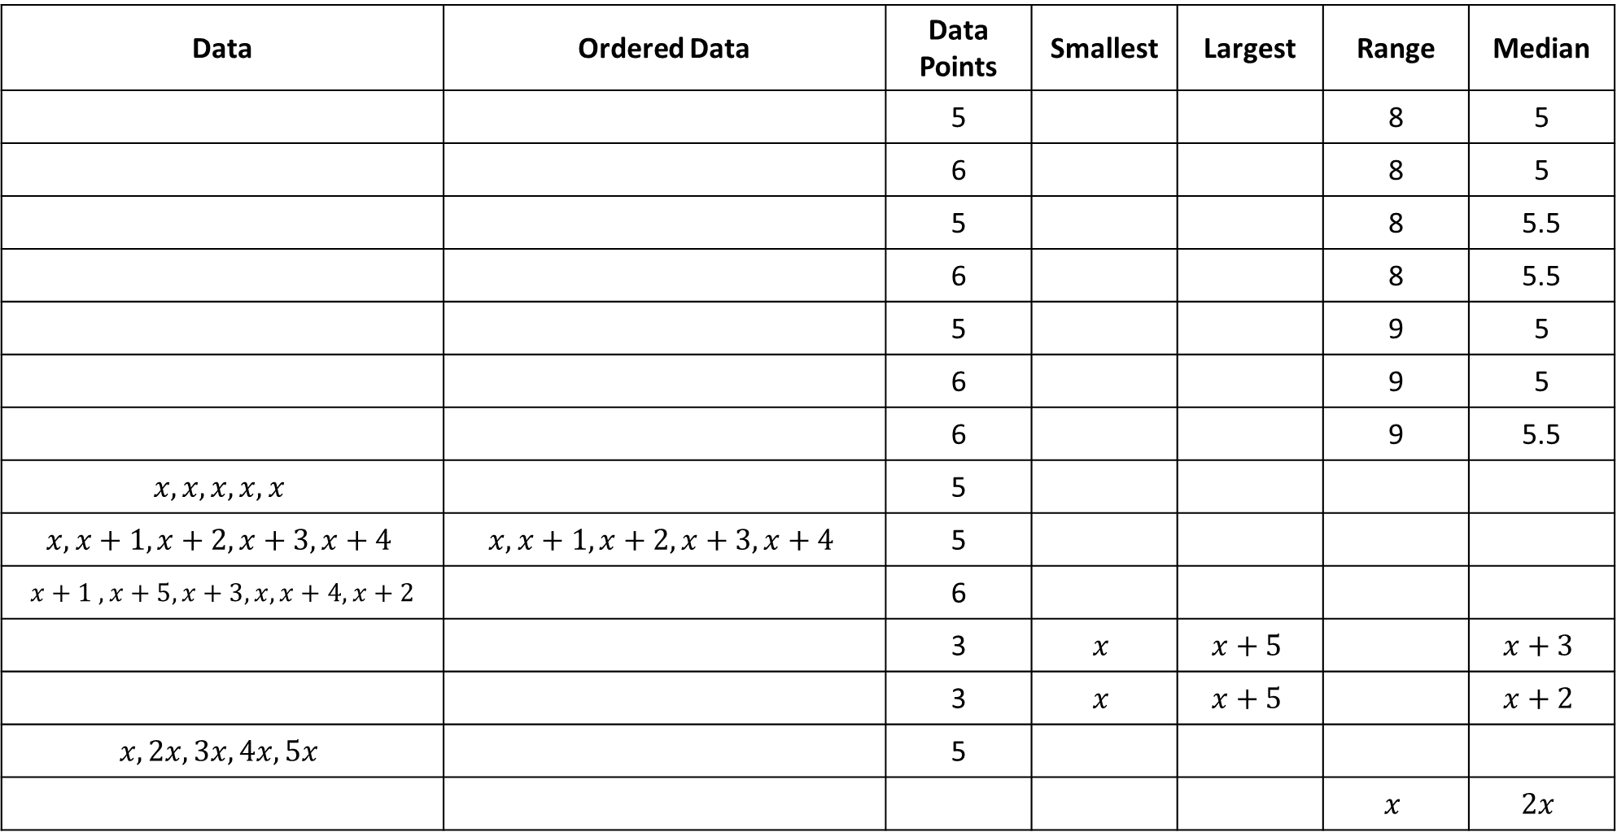
Red Zone: Task
Data | Ordered Data | Data Points | Smallest | Largest | Range | Median
 |  | 5 |  |  | 8 | 5
 |  | 6 |  |  | 8 | 5
 |  | 5 |  |  | 8 | 5.5
 |  | 6 |  |  | 8 | 5.5
 |  | 5 |  |  | 9 | 5
 |  | 6 |  |  | 9 | 5
 |  | 6 |  |  | 9 | 5.5
$$x, x, x,x,x$$ |  | 5
$$x, x+1, x+2,x+3,x+4$$ | $$x, x+1, x+2,x+3,x+4$$ | 5
$$x+1 ,x+5,x+3,x, x+4,x+2$$ |  | 6
 |  | 3 | $$x$$ | $$x+5$$ |  | $$x+3$$
 |  | 3 | $$x$$ | $$x+5$$ |  | $$x+2$$
$$x, 2x, 3x, 4x, 5x$$ |  | 5
 |  |  |  |  | $$x$$ | $$2x$$

Slide 7
