Slide 1



Ratio Tables:
Moving to Generalisation
Kathryn Clark
Director of Learning (Maths), Dr FROST LEARNING
Kathryn@DrFrostMaths.com
@Arithmaticks

Slide 2
The Plan
A recap of ratio table notation (just in case!)
Algebraic direct proportion
Inverse proportion intro
Algebraic inverse proportion

Slide 3
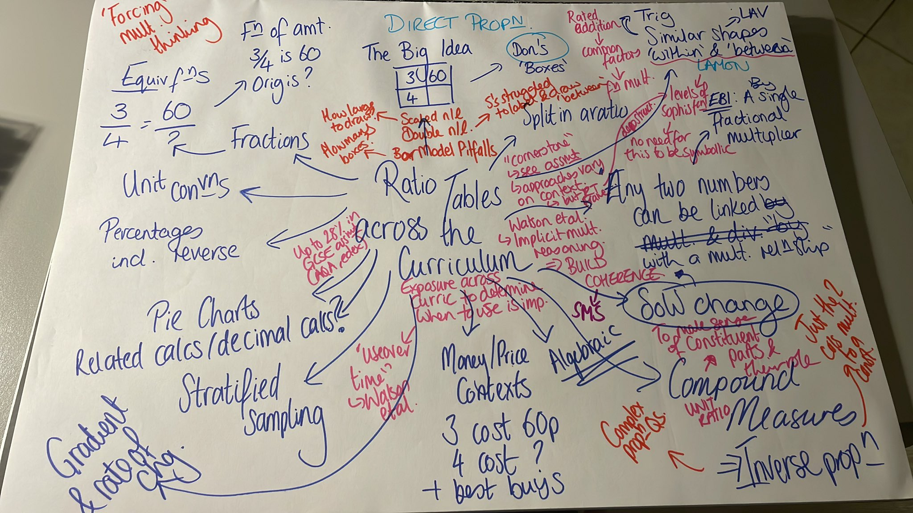
“Proportionality and some related concepts appear everywhere in the curriculum but are often treated implicitly.”
Anne Watson, Keith Jones and Dave Pratt (2013)
Key Ideas in Teaching Mathematics: Research-based guidance for ages 9-19, page 12

Slide 4




The Big Idea
Any two numbers can be connected by a
multiplicative relationship with a single multiplier.
$$×2$$
3 | 6
9 | 18
$$×3$$
$$×\frac{1}{3}$$
?
$$×\frac{1}{2}$$

Slide 5




The Big Idea
Sometimes one of these relationships is ‘more difficult’ than the other…
$$×\frac{6}{11}$$
11 | 6
55 | 30
$$×5$$
$$×\frac{1}{5}$$
?
$$×\frac{11}{6}$$

Slide 6




The Big Idea
Sometimes neither direction is very pretty…
But if you know about reciprocals as multiplicative inverse, you’re all set!
$$×\frac{3}{2}$$
4 | 6
10 | 15
$$×\frac{5}{2}$$
$$×\frac{2}{5}$$
?
$$×\frac{2}{3}$$

Slide 7

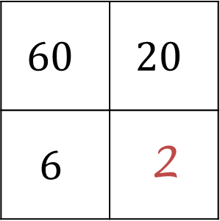
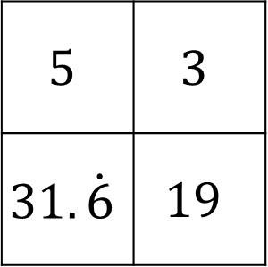
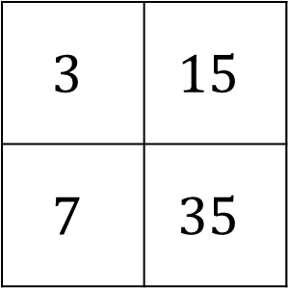
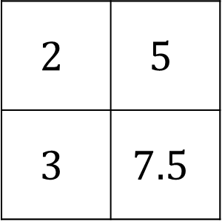
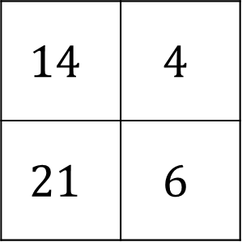
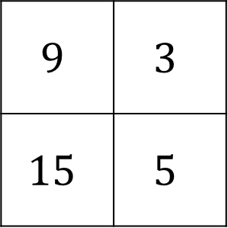

Deeper Thinking
What has she done?
Does Kathryn’s method always work?
Justify your answer.
Kathryn thinks she has spotted something useful and answers the first question like this:
$$9$$ | $$3$$
$$15$$ | $$5$$
$$3$$ | $$15$$
$$7$$ | $$35$$
?
$$60$$ | $$20$$
$$6$$ | 2
?
$$5$$ | $$3$$
$$31.\dot{6}$$ | $$19$$
$$14$$ | $$4$$
$$21$$ | $$6$$
$$2$$ | $$5$$
$$3$$ | $$7.5$$
?
?
$$20×6=120$$
?
$$120÷60=2$$

Slide 8
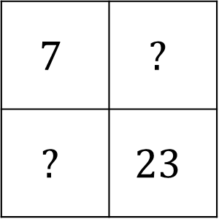
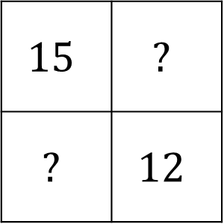
Deeper Thinking
What integers can be placed in the empty boxes
to create valid ratio tables?
How do you know?
a
$$15$$ | $$?$$
$$?$$ | $$12$$
b
$$7$$ | $$?$$
$$?$$ | $$23$$
How many ways can you complete the boxes if you can use fractions and decimals?

Slide 9
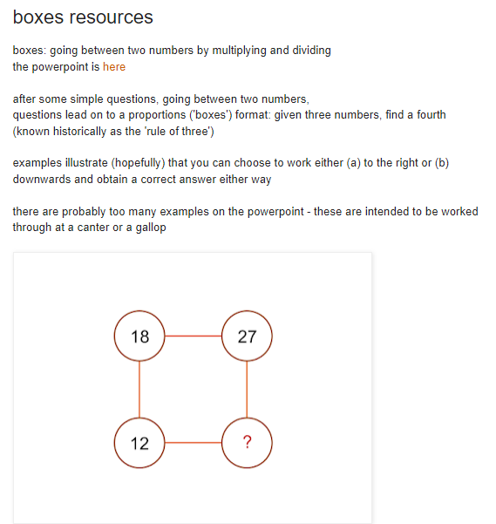
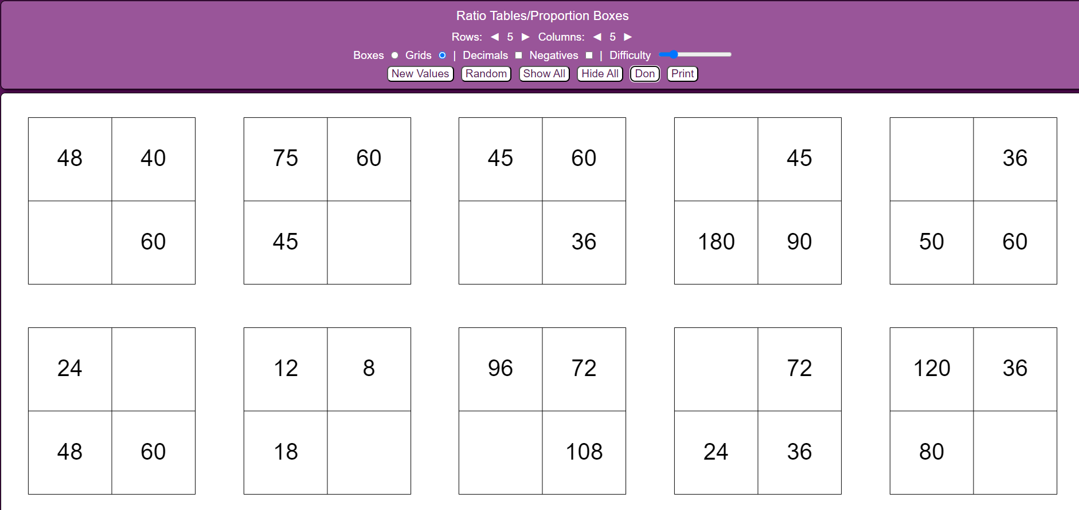
Practice
https://mathsbot.com/printables/boxes
https://donsteward.blogspot.com/2019/02/boxes-resources.html

Slide 10
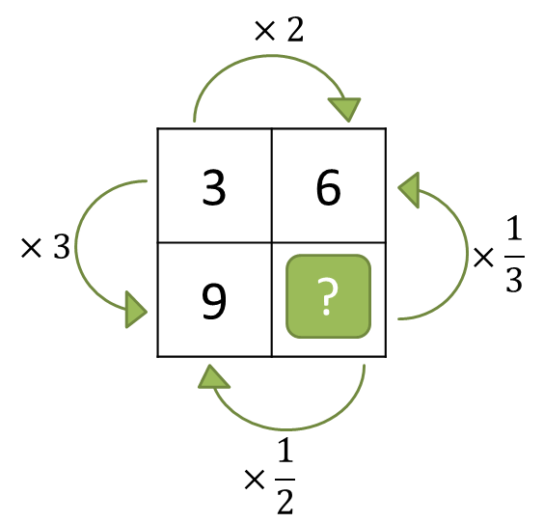
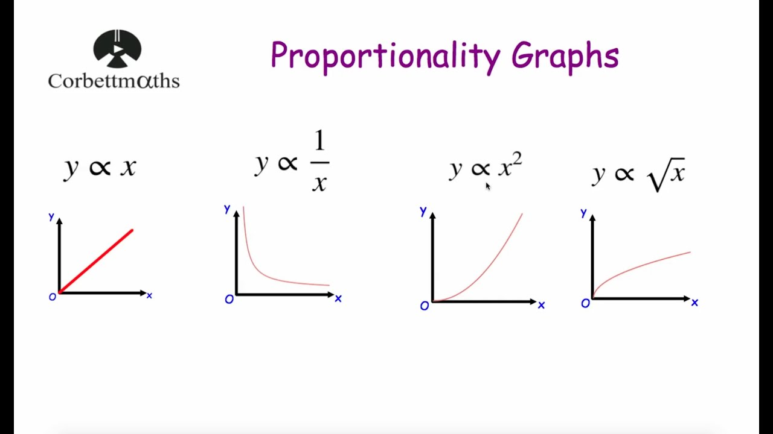


Direct Proportion
Definition: Diagrams & Features:
As one amount increases another
amount increases at the same rate.
Quantities are always in the
same ratio.
Examples: Non-Examples:
$$y=kx$$
Direct
Proportion

Slide 11





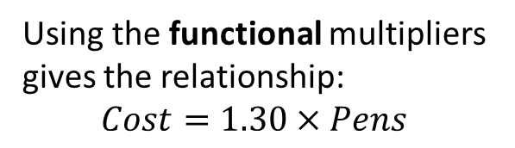
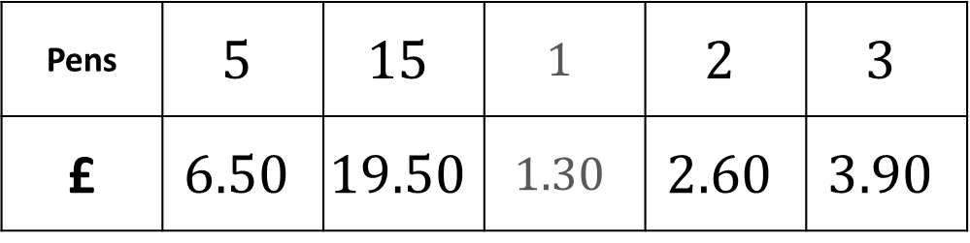

Paul buys 5 pens for £6.50
How much would he pay for:
15 pens?
2 pens?
3 pens?
How can we quicky find the cost of any number of pens?
a
Using the functional multipliers gives the relationship:
$$Cost=1.30×Pens$$
b
c
$$×\frac{1}{5}$$
$$×3$$
$$×3$$
$$×2$$
Top Tip:
We can add in the same unit!
So, if we know the cost of 1 & 2 pens, we could add these together to get the cost of 3!
Pens | $$5$$ | $$15$$ | $$1$$ | $$2$$ | $$3$$
£ | $$6.50$$ | $$19.50$$ | $$1.30$$ | $$2.60$$ | $$3.90$$
$$×1.30$$
?
?
?
?
$$×\frac{2}{5}$$

Slide 12
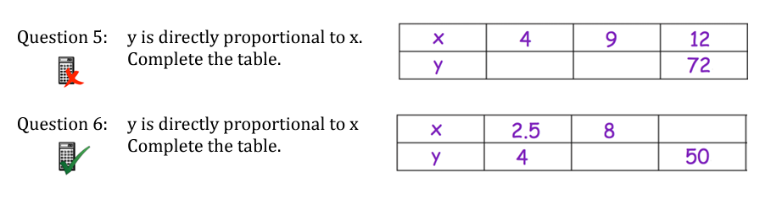







“Algebraic” Ratio Tables
$$×6$$
$$24$$
$$54$$
$$31.25$$
$$×\frac{8}{5}$$
$$×\frac{5}{8}$$
$$12.8$$
https://corbettmaths.com/wp-content/uploads/2019/03/Proportion-Direct-and-Inverse.pdf

Slide 13







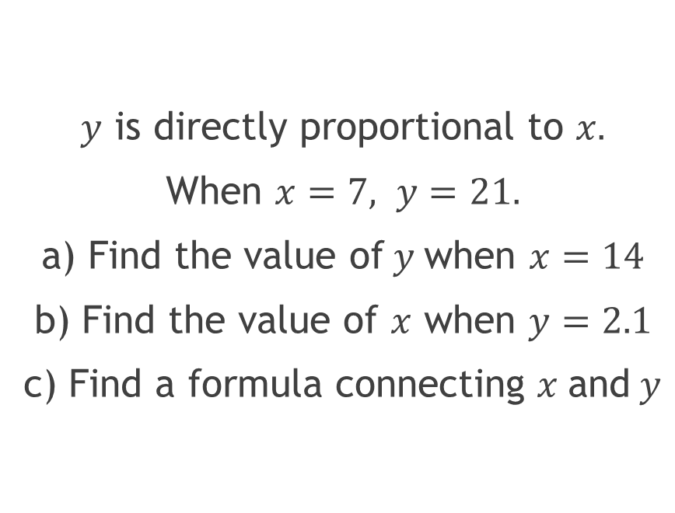



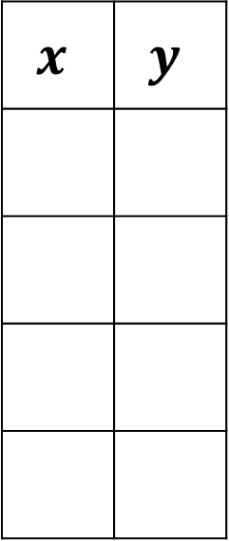





Algebraic Problems
$y$ is directly proportional to $x.$
When $x=7, y=21.$
a) Find the value of$y$when $x=14$
b) Find the value of $x$ when $y=2.1$
c) Find a formula connecting $x$ and $y$
$$×3$$
$$x$$ | $$y$$
$$y$$
$$7$$
$$21$$
$$×2$$
$$×2$$
$$×\frac{1}{10}$$
$$14$$
$$42$$
$$×\frac{1}{10}$$
a
b
$$0.7$$
$$2.1$$
$$y=3x$$
c
$$x$$
$$3x$$

Slide 14
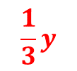
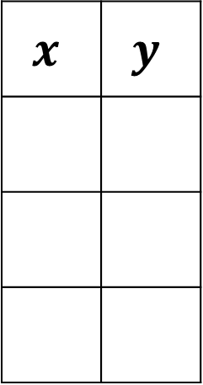


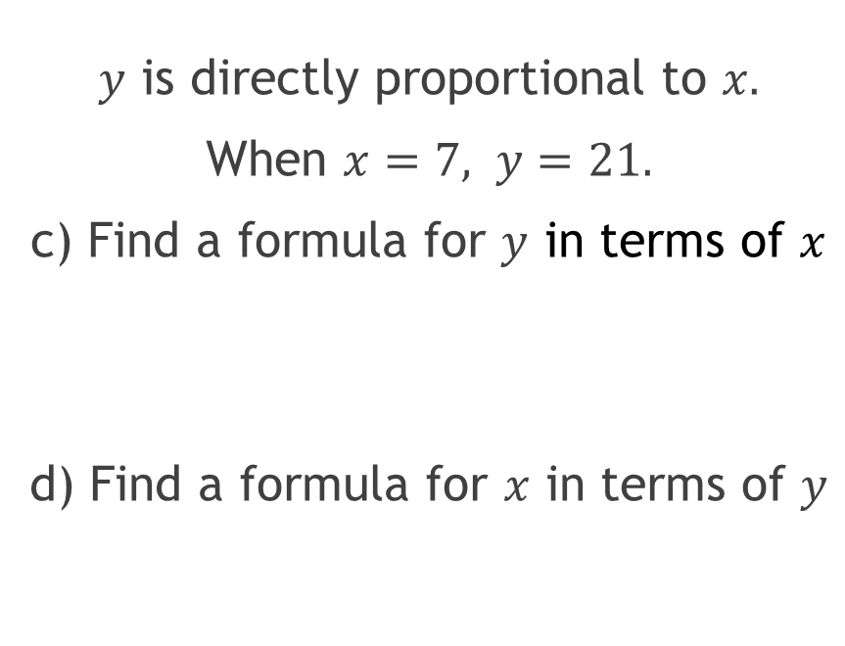

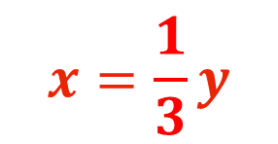




Algebraic Problems
$y$ is directly proportional to $x.$
When $x=7, y=21.$
c) Find a formula for $y$ in terms of $x$
d) Find a formula for $x$ in terms of $y$
$$×3$$
$$x$$ | $$y$$
$$x$$
$$7$$
$$21$$
$$y=3x$$
$$x$$
$$3x$$
$$\frac{1}{3}y$$
$$y$$
$$x=\frac{1}{3}y$$
$$×\frac{1}{3}$$

Slide 15



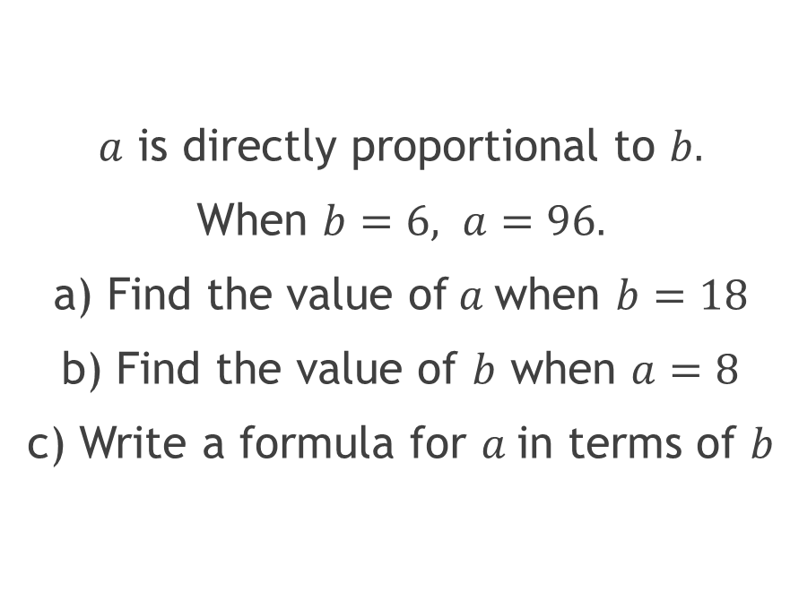



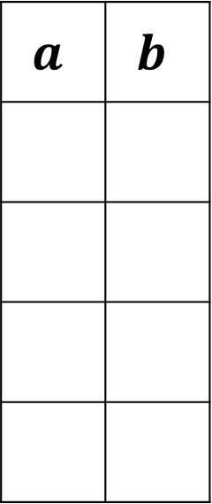










Your Turn
$a$ is directly proportional to $b.$
When $b=6, a=96.$
a) Find the value of$a$when $b=18$
b) Find the value of $b$ when $a=8$
c) Write a formula for $a$in terms of $b$
$$×\frac{1}{16}$$
$$a$$ | $$b$$
$$a$$
$$96$$
$$6$$
$$×3$$
$$×3$$
$$×\frac{1}{12}$$
a
$$×\frac{1}{12}$$
$$288$$
$$18$$
$$8$$
b
$$0.5$$
$$a=16b$$
c
$$16b$$
$$b$$
$$×16$$

Slide 16

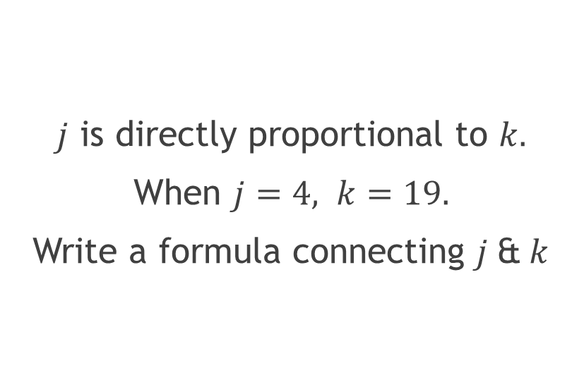

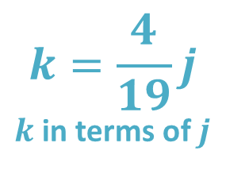
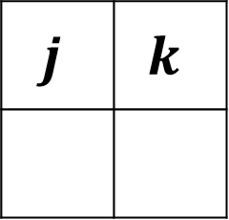

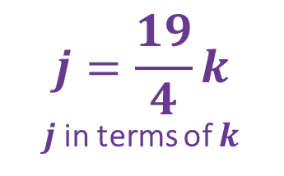
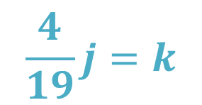

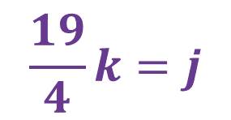
“Not nice” multipliers…
$j$ is directly proportional to $k.$
When $j=4, k=19.$
Write a formula connecting $j$&$k$
$$×\frac{19}{4}$$
$$j$$ | $$k$$
$$4$$
$$19$$
$$j=\frac{19}{4}k$$
$j$in terms of $k$
$$k=\frac{4}{19}j$$
$k$in terms of $j$
$$\frac{19}{4}k=j$$
$$\frac{4}{19}j=k$$
$$×\frac{4}{19}$$

Slide 17

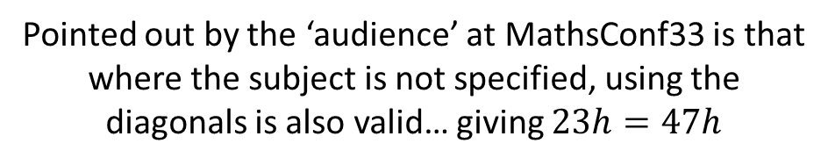
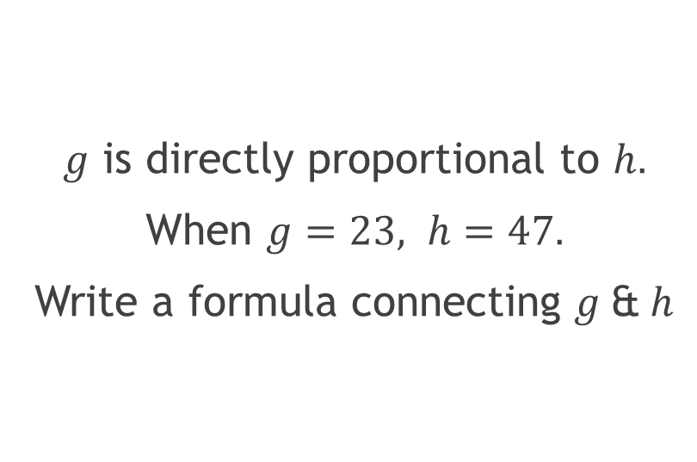

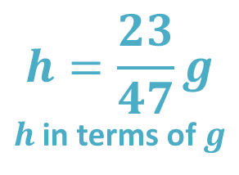
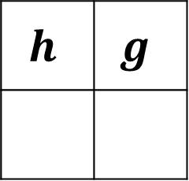

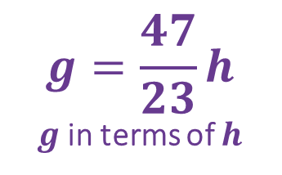
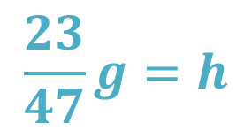

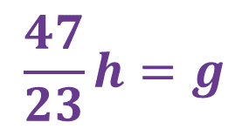
Your Turn
Pointed out by the ‘audience’ at MathsConf33 is that where the subject is not specified, using the diagonals is also valid… giving $23h=47h$
$g$ is directly proportional to $h.$
When $g=23, h=47.$
Write a formula connecting $g$&$h$
$$×\frac{47}{23}$$
$$h$$ | $$g$$
$$47$$
$$23$$
$$g=\frac{47}{23}h$$
$g$in terms of $h$
$$h=\frac{23}{47}g$$
$h$in terms of $g$
$$\frac{47}{23}h=g$$
$$\frac{23}{47}g=h$$
$$×\frac{23}{47}$$

Slide 18


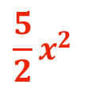
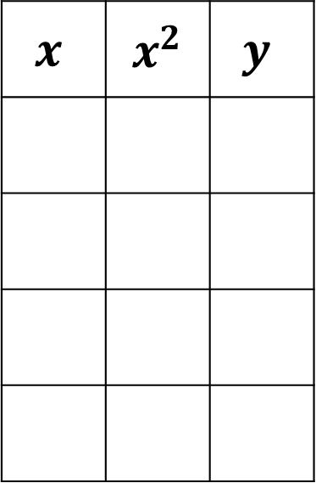



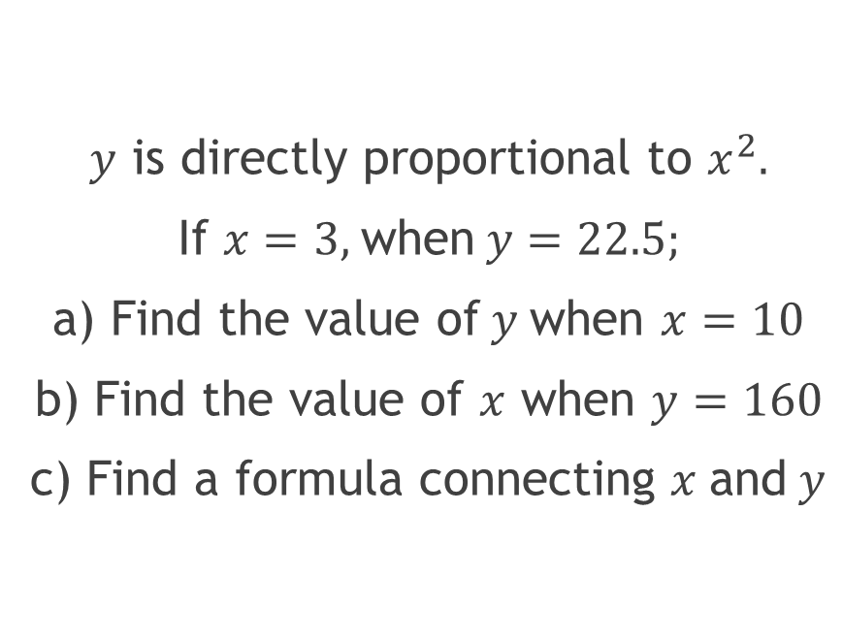


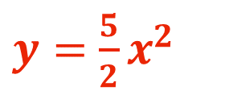







Adding Complexity…
$y$ is directly proportional to $x^{2}.$
If $x=3,$when$y=22.5;$
a) Find the value of$y$when $x=10$
b) Find the value of $x$ when $y=160$
c) Find a formula connecting $x$ and $y$
$$×\frac{5}{2}$$
$$x$$ | $${ x}^{2}$$ | $$y$$
$$y$$
$$3$$
$$9$$
$$22.5$$
$$10$$
$$100$$
$$250$$
a
$$8$$
$$64$$
$$160$$
b
c
$$x$$
$$x^{2}$$
$$\frac{5}{2}x^{2}$$
$y=$ $\frac{5}{2}x^{2}$
$$×\frac{2}{5}$$

Slide 19


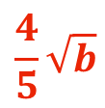
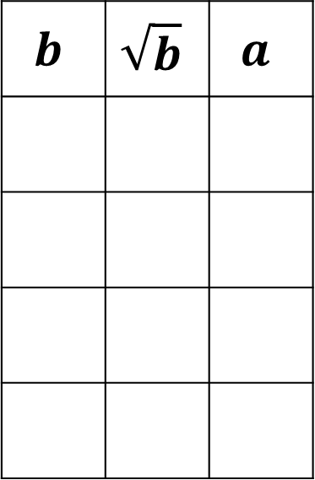



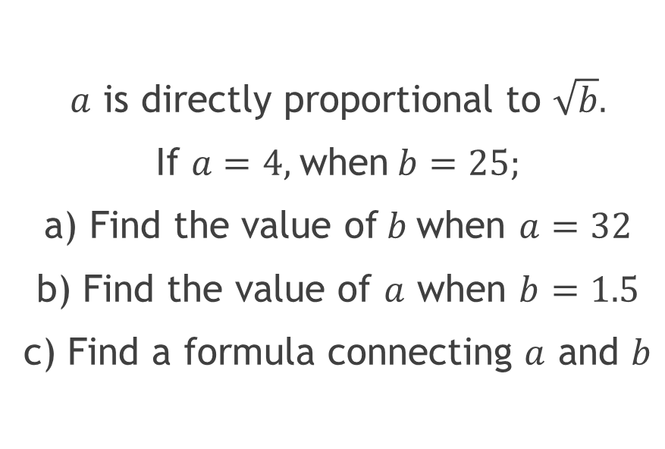


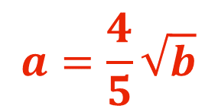







Your Turn
$a$ is directly proportional to $\sqrt{b}.$
If $a=4,$when$b=25;$
a) Find the value of$b$when $a=32$
b) Find the value of $a$ when $b=1.5$
c) Find a formula connecting $a$ and $b$
$$×\frac{4}{5}$$
$$b$$ | $$\sqrt{b}$$ | $$a$$
$$a$$
$$25$$
$$5$$
$$4$$
a
$$40$$
$$32$$
$$1600$$
$$1.5$$
$$2.25$$
b
$$1.8$$
c
$$b$$
$$\sqrt{b}$$
$$\frac{4}{5}\sqrt{b}$$
$$a=\frac{4}{5}\sqrt{b}$$
$$×\frac{5}{4}$$

Slide 20
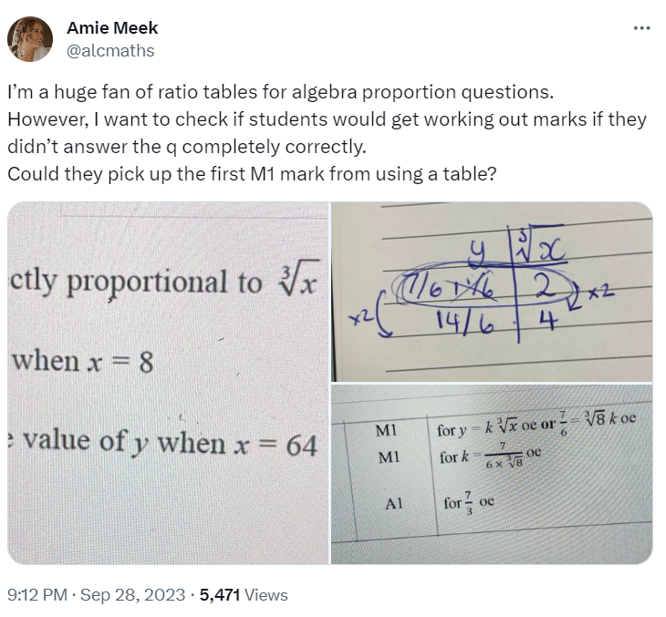
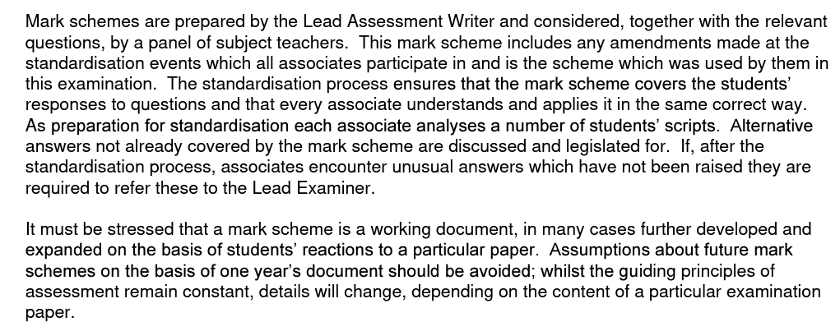
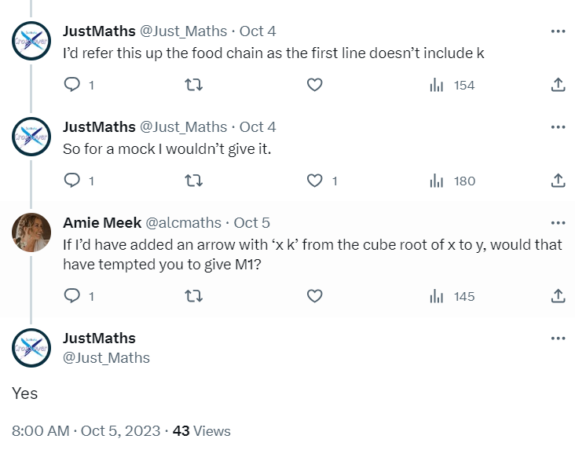
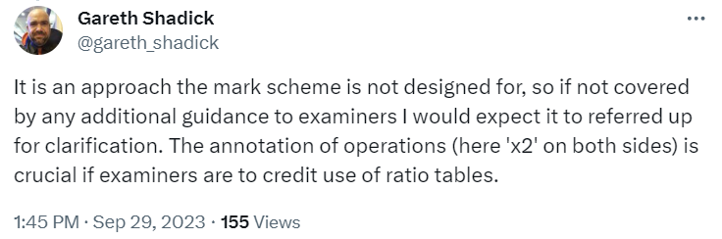
Exams…

Slide 21
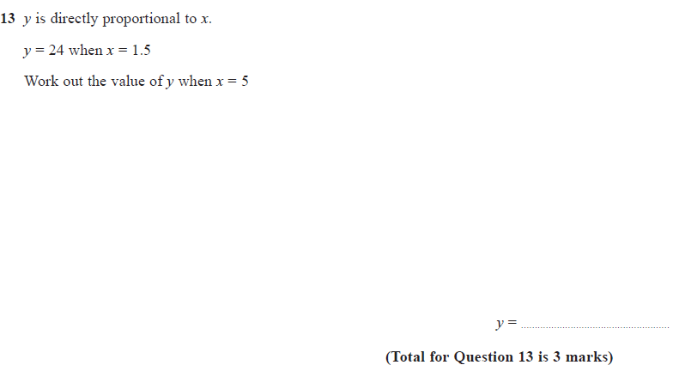


Exams…
[Edexcel 1MA1/1H, June 2023, Q13]

Slide 22












More than two variables…
$a$ is directly proportional to $b.$
$b$ is directly proportional to $c.$
If $a=4,$when$b=25$
and $b=3,$ when $c=12;$
Find a formula connecting $a$ and $c$
$$×\frac{25}{4}$$
$$×4$$
$$a$$ | $$b$$ | $$c$$
$$4$$
$$25$$
$$3$$
$$12$$
$$a$$
$$25a$$
$$c=25a$$
$$×\frac{25}{4}×4 \\ =×25$$

Slide 23





More than two variables…
In general, if there are two multipliers, $k$ & $l$, such that
$b=ka$and $c=lb$
Then we can combine these two multipliers to give a single multiplier between a and c.
$c=l\left(ka\right)=Ka$
$$×k$$
$$×l$$
$$a$$ | $$b$$ | $$c$$
$$×k×l=×K$$

Slide 24













Your Turn…
$x$ is directly proportional to $y.$
$y$ is directly proportional to $z^{2}.$
If $x=6,$when$y=18$
and $y=10,$ when $z=2;$
Find a formula connecting $x$ and $z$
$$×\frac{2}{5}$$
$$×3$$
$$x$$ | $$y$$ | $$z$$ | $$z^{2}$$
$$6$$
$$18$$
$$10$$
$$2$$
$$4$$
$$x$$
$$\frac{6}{5}x$$
$$z^{2}=\frac{6}{5}x$$
$$×3×\frac{2}{5} \\ =×\frac{6}{5}$$

Slide 25

















More complexity…
[Edexcel 1MA1/3H, Nov 2021, Q17]
$$×k$$
$$×c$$
$$x$$ | $$y$$ | $$y^{2}$$ | $$z$$ | $$z^{3}$$
$${(8k )}^{2}=64K$$
$$32$$
$$8k$$
$$2$$
$$8$$
$$x =Cz^{6}$$
$$x=64C$$
$$x=32$$
So $C=\frac{1}{2}$
$$=64C$$
$${({kz}^{3})}^{2}=k^{2}z^{6}=Kz^{6}$$
$$c(Kz^{6})=Cz^{6}$$
$$z^{3}$$
$${kz}^{3}$$
$${x=\frac{1}{2}z}^{6}$$

Slide 26







Inverse Proportion
[Edexcel 1MA1/1H, Nov 2022, Q13]
$$×\frac{1}{100}$$
$$500$$
$$×100$$
$$0.25$$
$$0.02$$

Slide 27




What is the same?
What is different?
1
The table shows the distance you can travel in various times at 30 miles per hour.
$$×2$$
Time (min) | 10 | 15 | 20 | 30 | 40 | 45 | 60
Distance (miles) | 5 | 7.5 | 10 | 15 | 20 | 22.5 | 30
$$×2$$
2
The table shows how long it would take to travel 30 miles at various speeds.
$$×2$$
Speed (mph) | 10 | 15 | 20 | 30 | 40 | 45 | 60
Time (h) | 3 | 2 | 1.5 | 1 | $$\frac{3}{4}$$ | $$\frac{2}{3}$$ | $$\frac{1}{2}$$
$$×\frac{1}{2}$$

Slide 28









Inverse Proportion
[Edexcel 1MA1/1H, Nov 2022, Q13]
$$×\frac{1}{4}$$
$$×\frac{1}{5}$$
$$×\frac{1}{10}$$
$$20$$
$$4$$
$$50$$
$$×4$$
$$×5$$
$$×10$$

Slide 29



What is the same?
What is different?
1
The table shows the distance you can travel in various times at 30 miles per hour.
Time (min) | 10 | 15 | 20 | 30 | 40 | 45 | 60
Distance (miles) | 5 | 7.5 | 10 | 15 | 20 | 22.5 | 30
$$×\frac{1}{2}$$
2
The table shows how long it would take to travel 30 miles at various speeds.
Speed (mph) | 10 | 15 | 20 | 30 | 40 | 45 | 60
Time (h) | 3 | 2 | 1.5 | 1 | $$\frac{3}{4}$$ | $$\frac{2}{3}$$ | $$\frac{1}{2}$$
$$Speed×Time=30$$
$$×?!$$

Slide 30






Inverse Proportion
2
The table shows how long it would take to travel 30 miles at various speeds.
Speed (mph) | 10 | 15 | 20 | 30 | 40 | 45 | 60
Time (h) | 3 | 2 | 1.5 | 1 | $$\frac{3}{4}$$ | $$\frac{2}{3}$$ | $$\frac{1}{2}$$
$$Speed×Time=30$$
$$T×S=D$$
$$S=\frac{D}{T}$$
$$S×T=D$$
$$T=\frac{D}{S}$$

Slide 31




Inverse Proportion
[Edexcel 1MA1/1H, Nov 2022, Q13]
$$100÷5=20$$
$$20$$
$$4$$
$$50$$
$$100÷25=4$$
$$100÷2=50$$
$$pt=100$$

Slide 32


Inverse Proportion
Definition: Diagrams & Features:
a relation between two quantities
such that one increases
in proportion as the other decreases,
& vice versa.
The product of the
quantities stays constant.
Examples: Non-Examples:
Builders & days to complete a job Cost & Materials needed to complete a building project
Speed & time given a specific Distance and time to maintain
distance a specific speed
$$xy=k$$
$$y=\frac{k}{x}$$
Inverse
Proportion

Slide 33








Algebraic Problems
$y$ is inversely proportional to $x.$
When $x=4, y=18.$
a) Find the value of$y$when $x=6$
b) Find the value of $x$ when $y=6$
c) Find a formula connecting $x$ and $y$
$$x$$ | $$y$$
$$4$$
$$18$$
$$6$$
$$12$$
a
$$12$$
b
$$6$$
$$xy=72$$
c

Slide 34





Algebraic Problems
$y$ is inversely proportional to $x.$
When $x=4, y=18.$
a) Find a formula for $x$ in terms of $y$
b) Find a formula for $x$ in terms of $y$
$$x$$ | $$y$$
$$4$$
$$18$$
$$x=\frac{72}{y}$$
$$xy=72$$
$$y=\frac{72}{x}$$

Slide 35











Your Turn
$r$ is inversely proportional to $t.$
When $r=6, t=35.$
a) Find the value of$t$ when $r=15$
b) Find the value of $r$ when $t=0.7$
c) Find 3 formulae connecting $r$ and $t$
$$r$$ | $$t$$
$$6$$
$$35$$
$$15$$
$$14$$
a
b
$$0.7$$
$$300$$
$$rt=210$$
$$r=\frac{210}{t}$$
$$t=\frac{210}{r}$$

Slide 36







Direct or Inverse?
$$x$$ | 3 | 9 | 12 | 15 | 30
$$y$$ | 60 | 20 | 15 | 12 | 6
Inverse
$$xy=180$$
1
$$a$$ | 4 | 5 | 8 | 10 | 15
$$b$$ | 7.5 | 6 | 3.75 | 3 | 2
Inverse
$$ab=30$$
2
$$j$$ | 3 | 9 | 12 | 15 | 30
$$k$$ | 60 | 120 | 150 | 180 | 330
3
Neither
$$p$$ | 4 | 5 | 8 | 10 | 15
$$q$$ | 3 | 3.75 | 6 | 7.5 | 11.25
Direct
$$q=\frac{3}{4}p$$
4

Slide 37






Adding Complexity
$a$ is inversely proportional to $b^{2}.$
If $a=3,$when$b=10;$
Find a formula connecting $a$ and $b$
$$a$$ | $$b$$ | $$b^{2}$$
$$3$$
$$10$$
$$100$$
$$ab^{2}=300$$

Slide 38






Your Turn
[Edexcel 1MA1/1H, June 2017, Q13]
$$x^{2}$$ | 1 | 4 | 9 | 16
$$\frac{9}{16}$$
$$\frac{3}{4}$$
16
$$y=\frac{9}{x^{2}}$$
$$x^{2}y=9$$
$$\frac{3}{4}$$

Slide 39











More than two variables…
[Edexcel 1MA1/1H, June 2017, Q13]
$$×\frac{1}{2}$$
$$h$$ | $$p$$ | $$\sqrt{t}$$ | $$t$$
$$10$$
$$6$$
$$12$$
$$144$$
$$hp=60$$
$$h\frac{\sqrt{t}}{2}=60$$
$$h=\frac{120}{\sqrt{t}}$$
$$p=\frac{\sqrt{t}}{2}$$

Slide 40










Slide 41
Ratio Tables:
Moving to Generalisation
Kathryn Clark
Director of Learning (Maths), Dr FROST LEARNING
Kathryn@DrFrostMaths.com
@Arithmaticks

