Slide 1



Breaking Up with Formulae:
Ratio Tables are “The One”
Kathryn Clark
Regional Lead practitioner for Maths (South Yorkshire),
AsTREA ACADEMIES TRUST
Arithmaticks@GMAIL.COM
@Arithmaticks @Arithmaticks.BSKY.SOCIAL

Slide 2
The Plan
A recap of ratio table notation (just in case!)
Algebraic direct proportion
Inverse proportion intro
Algebraic inverse proportion

Slide 3
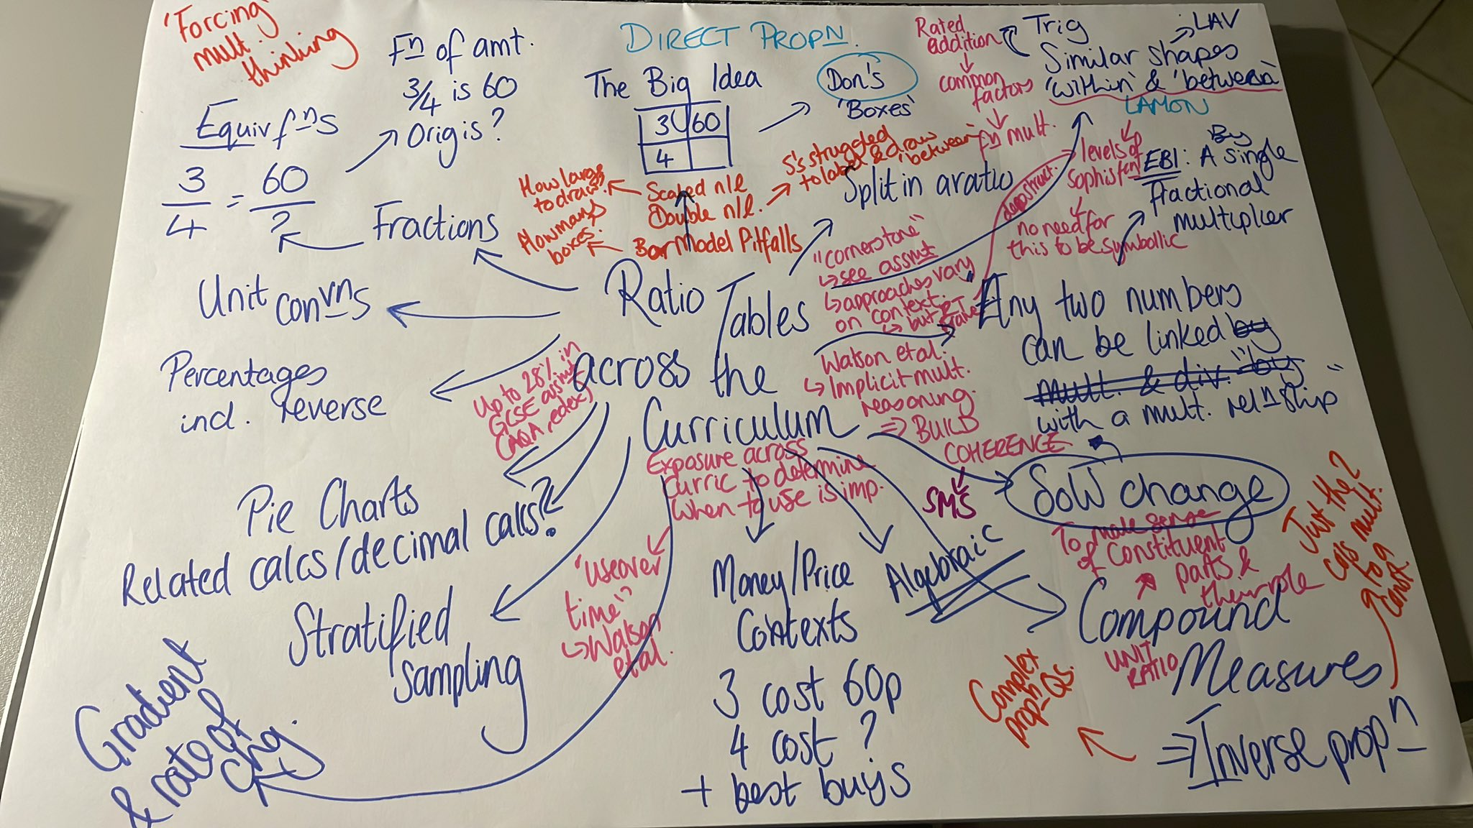
“Proportionality and some related concepts appear everywhere in the curriculum but are often treated implicitly.”
Anne Watson, Keith Jones and Dave Pratt (2013)
Key Ideas in Teaching Mathematics: Research-based guidance for ages 9-19, page 12

Slide 4




The Big Idea
Any two numbers can be connected by a
multiplicative relationship with a single multiplier.
$$×2$$
3 | 6
9 | 18
$$×3$$
$$×\frac{1}{3}$$
?
$$×\frac{1}{2}$$

Slide 5




The Big Idea
Sometimes one of these relationships is ‘more difficult’ than the other…
$$×\frac{6}{11}$$
11 | 6
55 | 30
$$×5$$
$$×\frac{1}{5}$$
?
$$×\frac{11}{6}$$

Slide 6




The Big Idea
Sometimes neither direction is very pretty…
But if you know about reciprocals as multiplicative inverse, you’re all set!
$$×\frac{3}{2}$$
4 | 6
10 | 15
$$×\frac{5}{2}$$
$$×\frac{2}{5}$$
?
$$×\frac{2}{3}$$

Slide 7
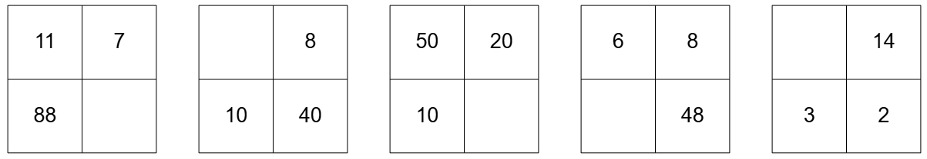
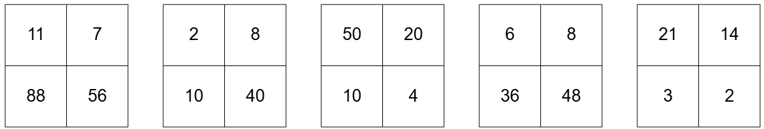
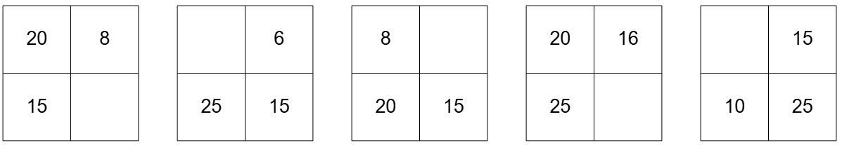
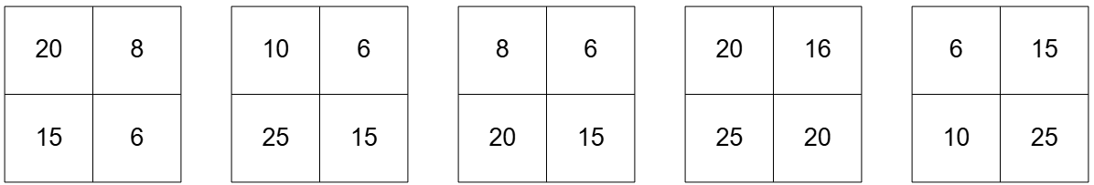
Ratio Table Recap

Slide 8
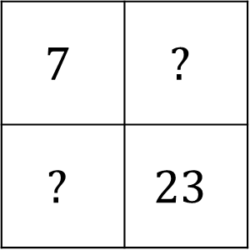
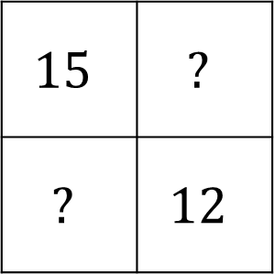
Deeper Thinking
What integers can be placed in the empty boxes
to create valid ratio tables?
How do you know?
a
$$15$$ | $$?$$
$$?$$ | $$12$$
b
$$7$$ | $$?$$
$$?$$ | $$23$$
How many ways can you complete the boxes if you can use fractions and decimals?

Slide 9
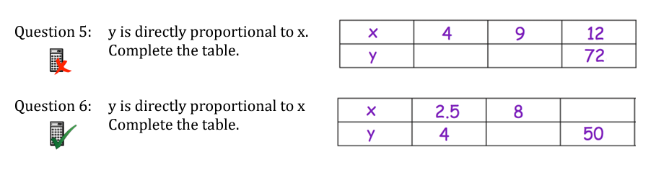
“Algebraic” Ratio Tables
https://corbettmaths.com/wp-content/uploads/2019/03/Proportion-Direct-and-Inverse.pdf

Slide 10
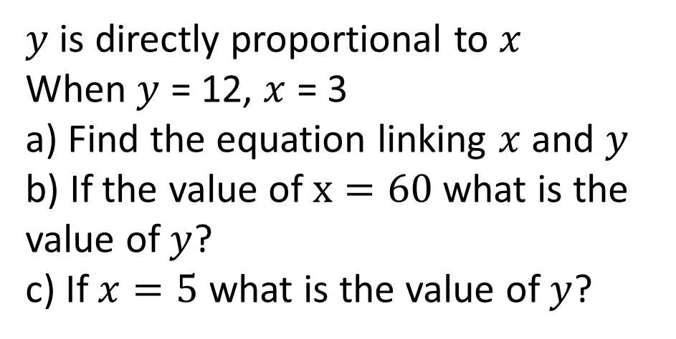
Algebraic Problems
$y$ is directly proportional to $x$
When $y$ = 12, $x$ = 3
a) Find the equation linking $x$ and $y$
b) If the value of $x=60$what is the value of $y$?
c) If $x=5$ what is the value of $y$?

Slide 11
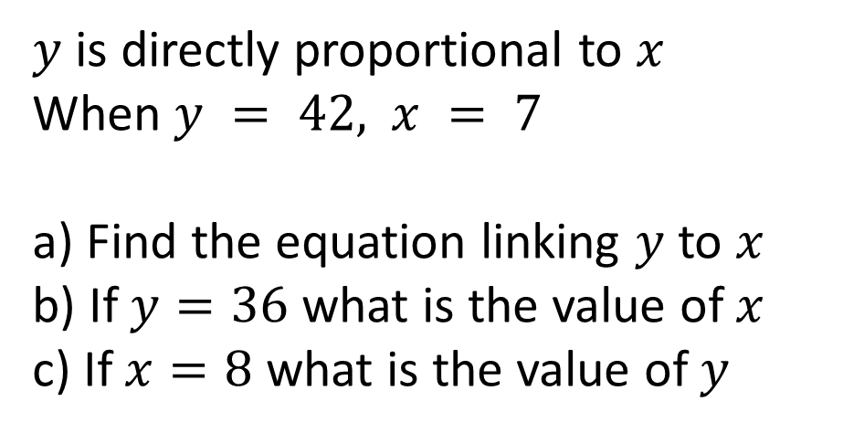
Your Turn
$y$ is directly proportional to $x$
When $y = 42,$ $x = 7$
a) Find the equation linking $y$ to $x$
b) If $y=36$ what is the value of $x$
c) If $x=8$ what is the value of $y$

Slide 12
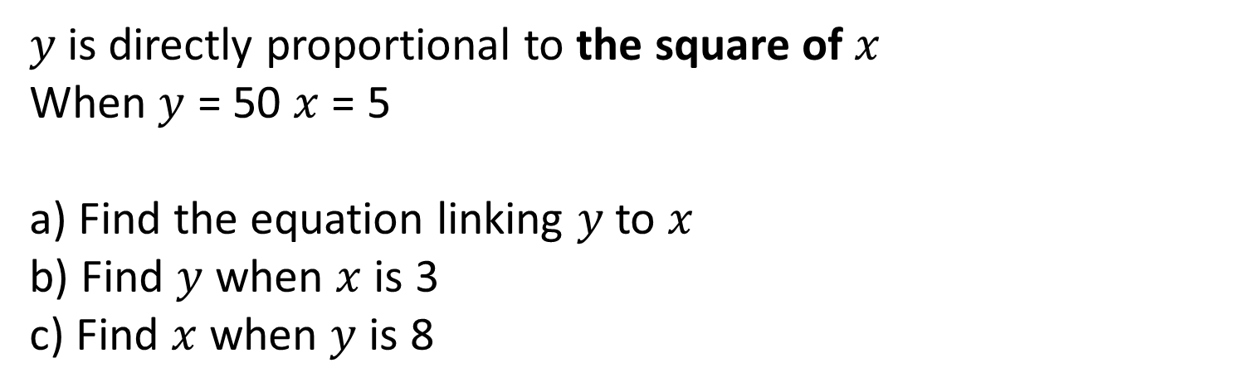
Adding Complexity…
$y$is directly proportional to the square of $x$
When $y$ = 50 $x$ = 5
a) Find the equation linking $y$to $x$
b) Find $y$ when $x$ is 3
c) Find $x$ when $y$ is 8

Slide 13
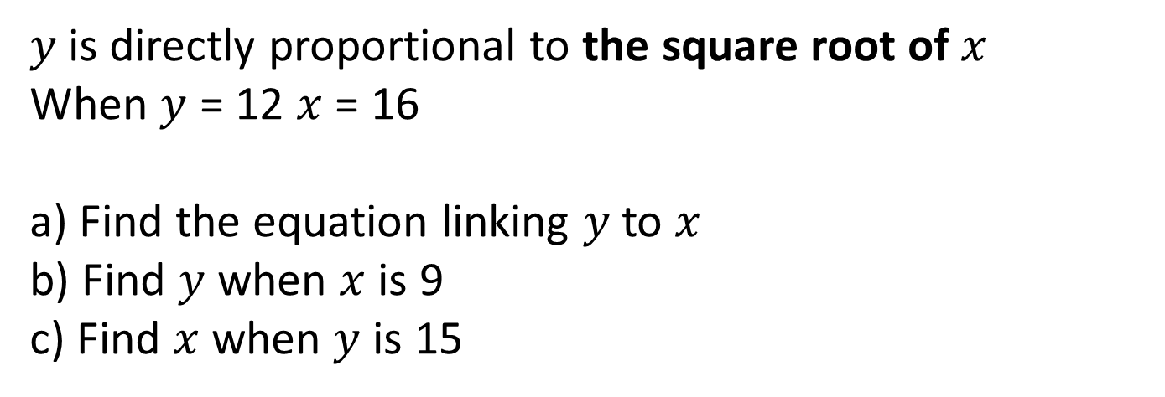
Your Turn
$y$is directly proportional to the square root of $x$
When $y$ = 12 $x$ = 16
a) Find the equation linking $y$to $x$
b) Find $y$ when $x$ is 9
c) Find $x$ when $y$ is 15

Slide 14
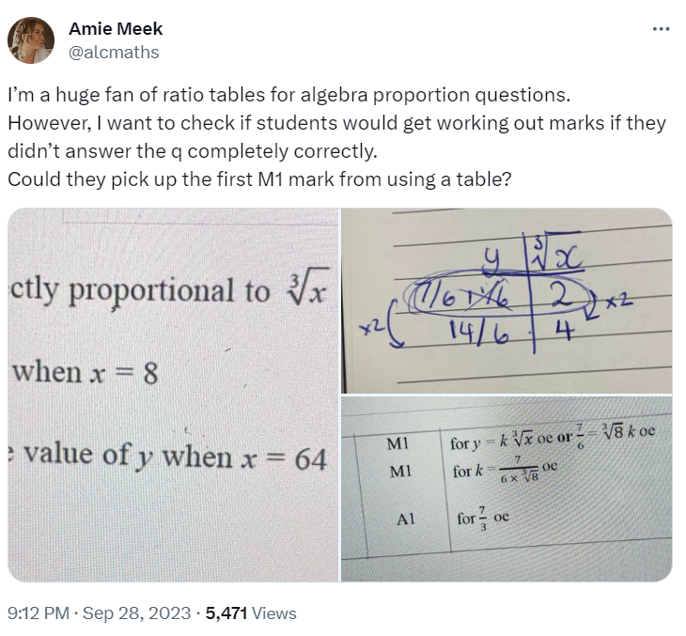
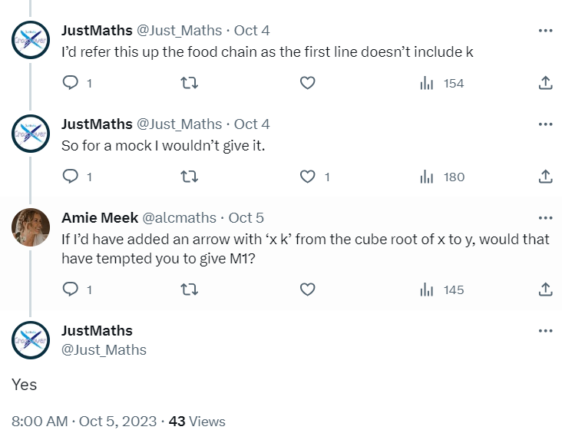
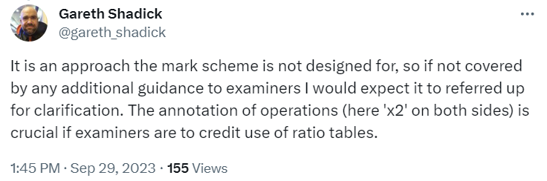
Exams…

Slide 15
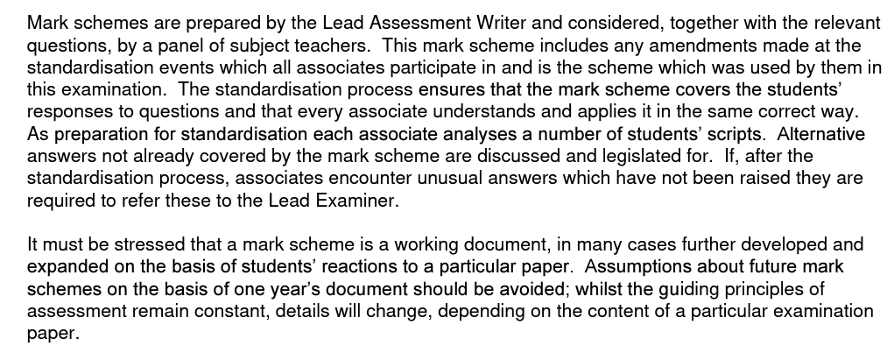
Exams…

Slide 16
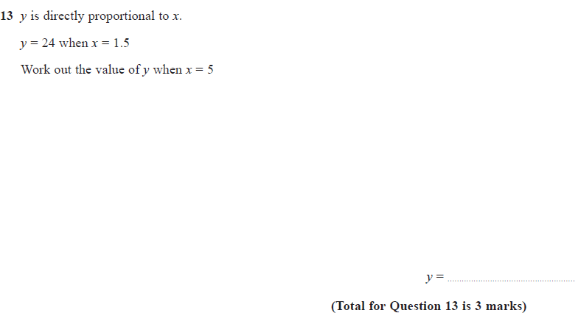
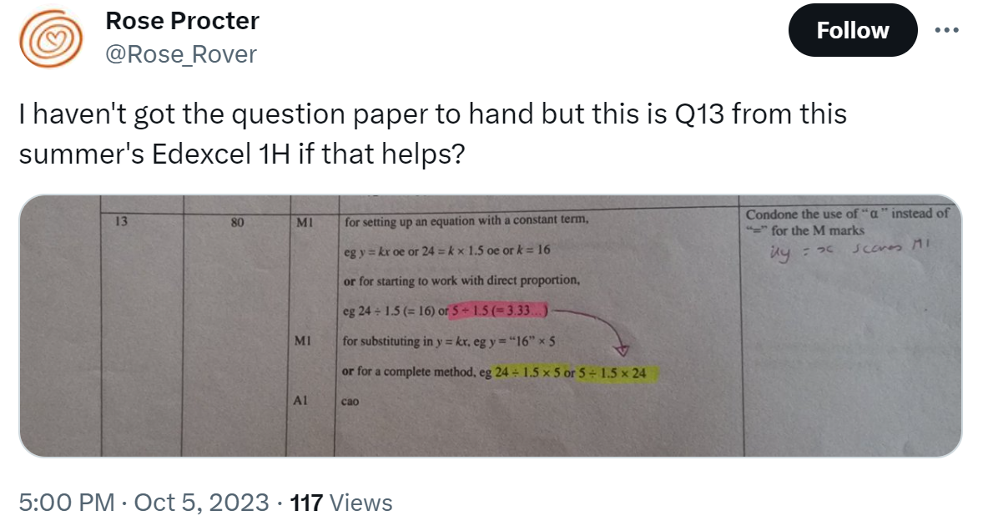

Exams…
[Edexcel 1MA1/1H, June 2023, Q13]

Slide 17
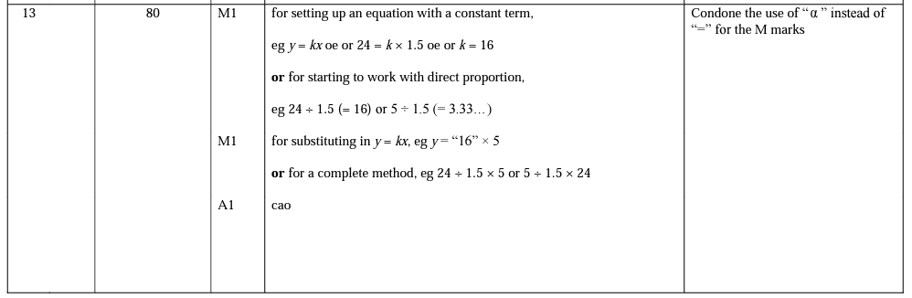
Exams…
[Edexcel 1MA1/1H, June 2023, Q13]

Slide 18
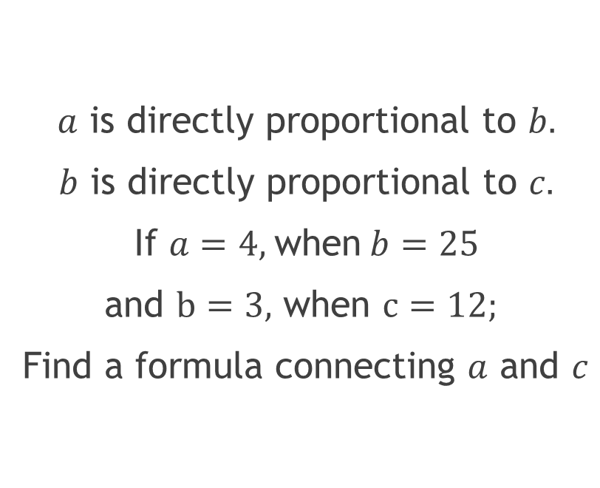
More than two variables…
$a$ is directly proportional to $b.$
$b$ is directly proportional to $c.$
If $a=4,$when$b=25$
and $b=3,$ when $c=12;$
Find a formula connecting $a$ and $c$

Slide 19
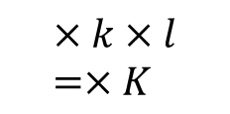
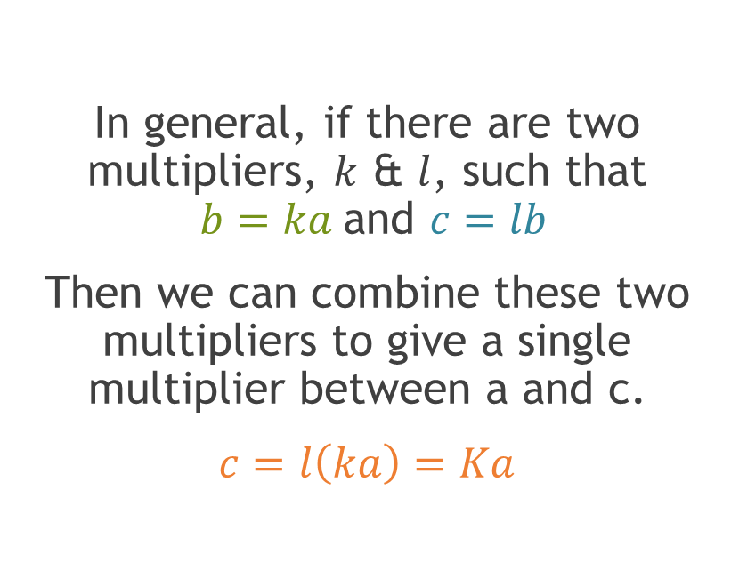


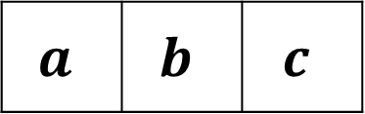
More than two variables…
In general, if there are two multipliers, $k$ & $l$, such that
$b=ka$and $c=lb$
Then we can combine these two multipliers to give a single multiplier between a and c.
$c=l\left(ka\right)=Ka$
$$×k$$
$$×l$$
$$a$$ | $$b$$ | $$c$$
$$×k×l=×K$$

Slide 20
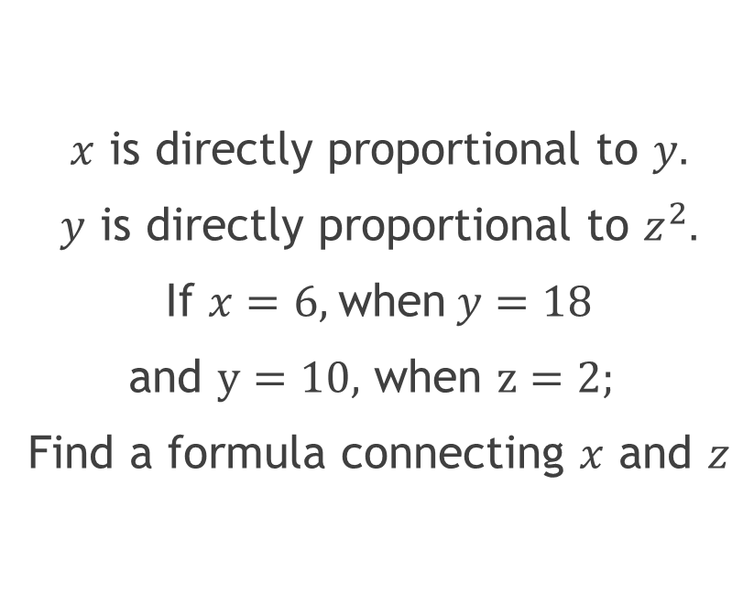
Your Turn…
$x$ is directly proportional to $y.$
$y$ is directly proportional to $z^{2}.$
If $x=6,$when$y=18$
and $y=10,$ when $z=2;$
Find a formula connecting $x$ and $z$

Slide 21
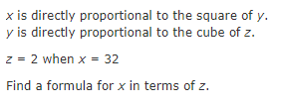

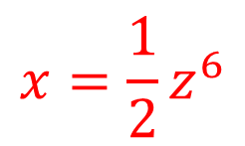
More complexity…
[Edexcel 1MA1/3H, Nov 2021, Q17]
$${x=\frac{1}{2}z}^{6}$$

Slide 22
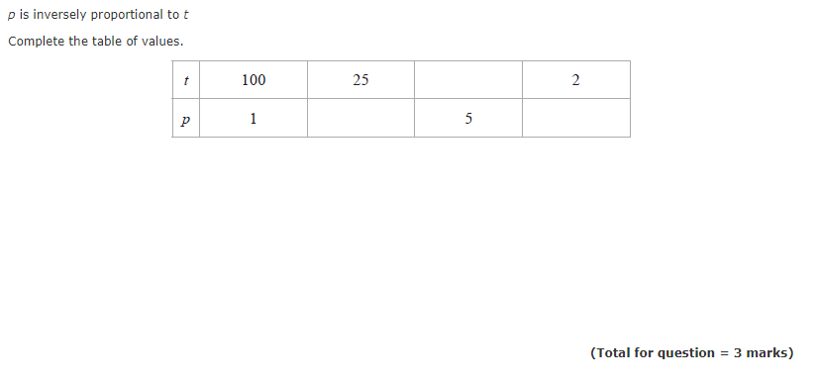

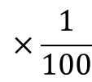




Inverse Proportion
[Edexcel 1MA1/1H, Nov 2022, Q13]
$$×\frac{1}{100}$$
$$500$$
$$×100$$
$$0.25$$
$$0.02$$

Slide 23
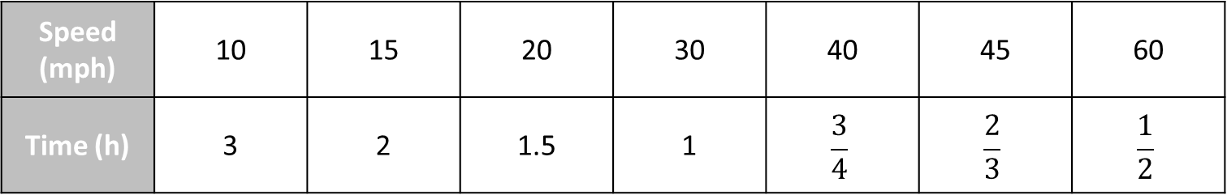
What is the same?
What is different?
1
The table shows the distance you can travel in various times at 30 miles per hour.
Time (min) | 10 | 15 | 20 | 30 | 40 | 45 | 60
Distance (miles) | 5 | 7.5 | 10 | 15 | 20 | 22.5 | 30
2
The table shows how long it would take to travel 30 miles at various speeds.
Speed (mph) | 10 | 15 | 20 | 30 | 40 | 45 | 60
Time (h) | 3 | 2 | 1.5 | 1 | $$\frac{3}{4}$$ | $$\frac{2}{3}$$ | $$\frac{1}{2}$$

Slide 24
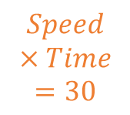





Inverse Proportion
2
The table shows how long it would take to travel 30 miles at various speeds.
Speed (mph) | 10 | 15 | 20 | 30 | 40 | 45 | 60
Time (h) | 3 | 2 | 1.5 | 1 | $$\frac{3}{4}$$ | $$\frac{2}{3}$$ | $$\frac{1}{2}$$
$$Speed×Time=30$$
$$T×S=D$$
$$S=\frac{D}{T}$$
$$S×T=D$$
$$T=\frac{D}{S}$$

Slide 25
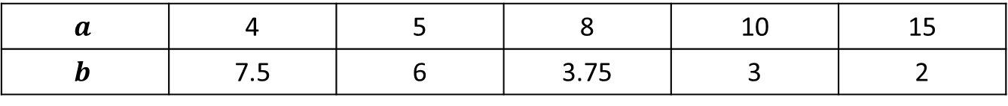
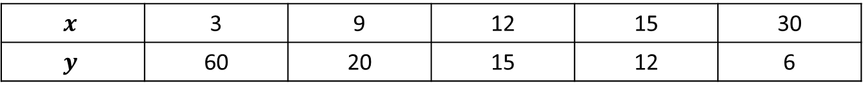
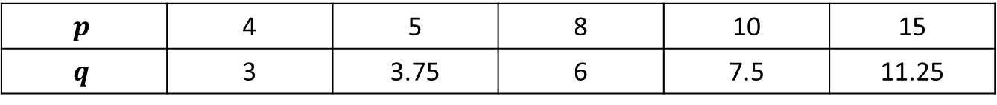
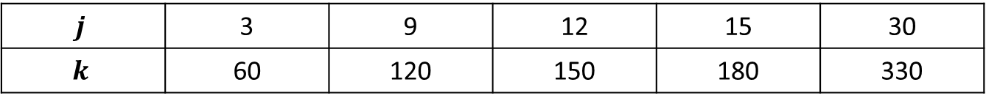
Direct or Inverse?
$$x$$ | 3 | 9 | 12 | 15 | 30
$$y$$ | 60 | 20 | 15 | 12 | 6
1
$$a$$ | 4 | 5 | 8 | 10 | 15
$$b$$ | 7.5 | 6 | 3.75 | 3 | 2
2
$$j$$ | 3 | 9 | 12 | 15 | 30
$$k$$ | 60 | 120 | 150 | 180 | 330
3
$$p$$ | 4 | 5 | 8 | 10 | 15
$$q$$ | 3 | 3.75 | 6 | 7.5 | 11.25
4

Slide 26
Inverse Proportion
[Edexcel 1MA1/1H, Nov 2022, Q13]

Slide 27
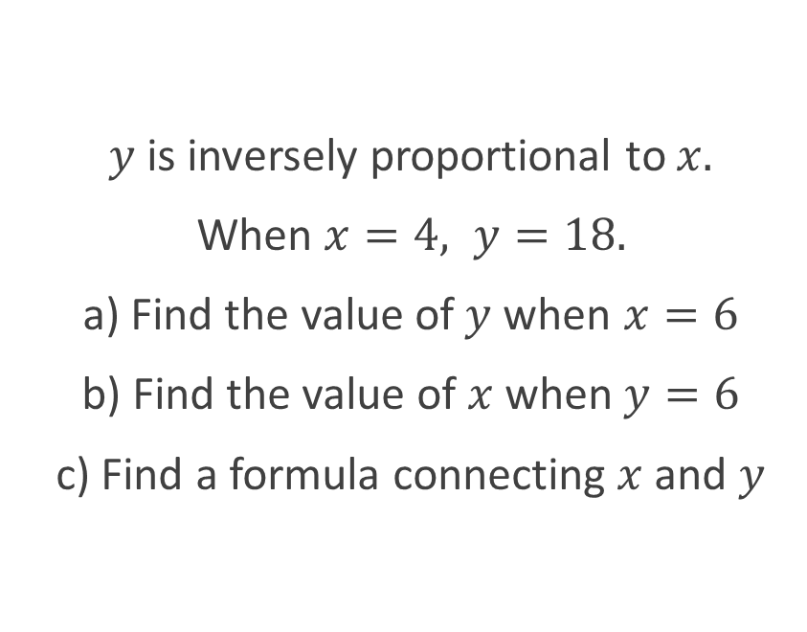
Algebraic Problems
$y$ is inversely proportional to $x.$
When $x=4, y=18.$
a) Find the value of$y$when $x=6$
b) Find the value of $x$ when $y=6$
c) Find a formula connecting $x$ and $y$

Slide 28
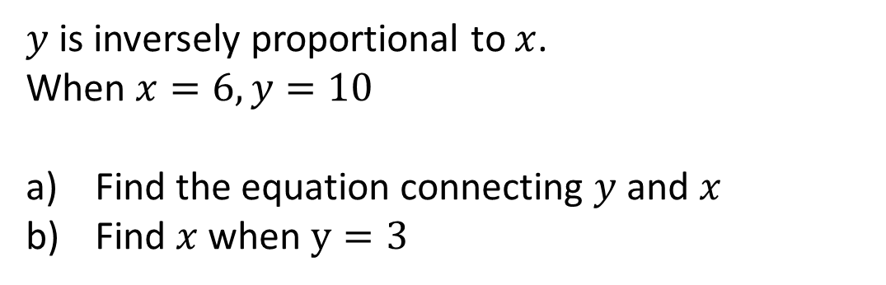
Your turn…
$y$ is inversely proportional to $x$.
When $x=6, y=10$
Find the equation connecting $y$and $x$
Find $x$ when $y=3$

Slide 29
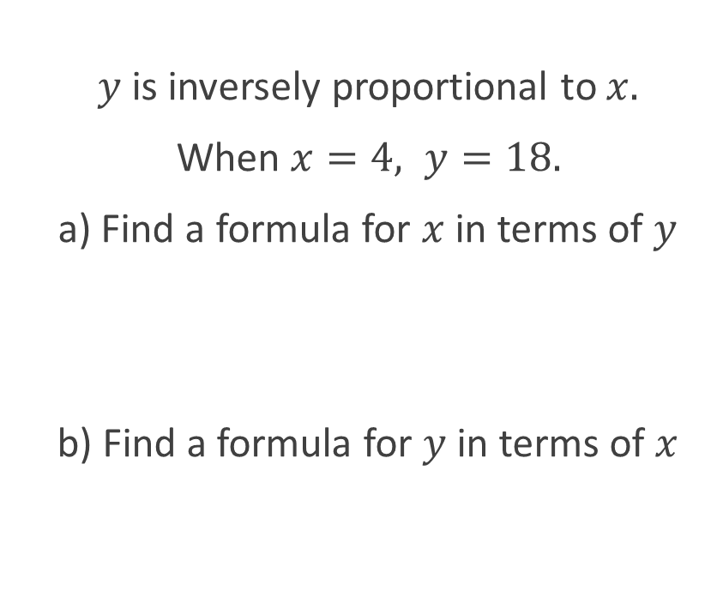
Algebraic Problems
$y$ is inversely proportional to $x.$
When $x=4, y=18.$
a) Find a formula for $x$ in terms of $y$
b) Find a formula for $y$ in terms of $x$

Slide 30
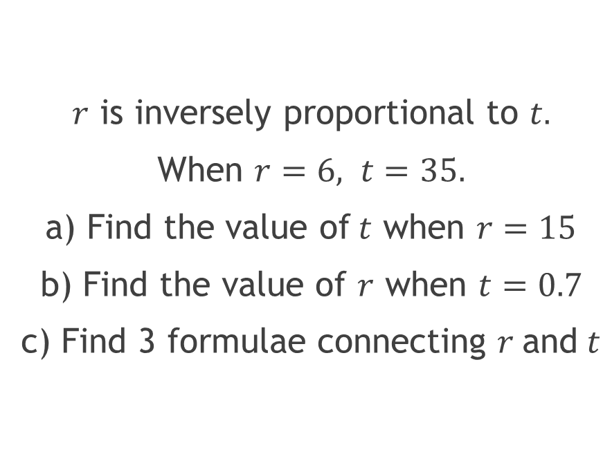
Your Turn
$r$ is inversely proportional to $t.$
When $r=6, t=35.$
a) Find the value of$t$ when $r=15$
b) Find the value of $r$ when $t=0.7$
c) Find 3 formulae connecting $r$ and $t$

Slide 31
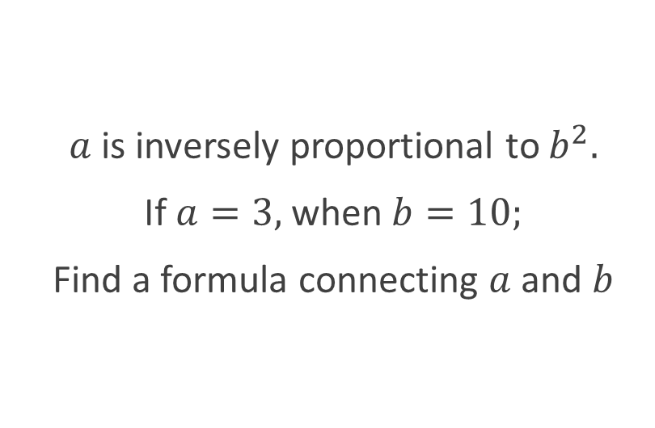
Adding Complexity
$a$ is inversely proportional to $b^{2}.$
If $a=3,$when$b=10;$
Find a formula connecting $a$ and $b$

Slide 32
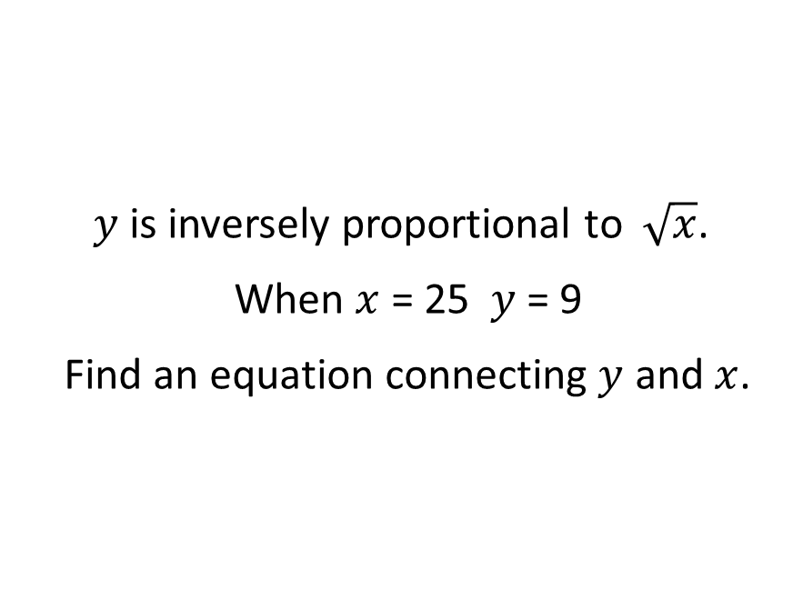
Your Turn
$y$ is inversely proportional to $\sqrt{x}$.
When $x$ = 25 $y$ = 9
Find an equation connecting $y$ and $x$.

Slide 33
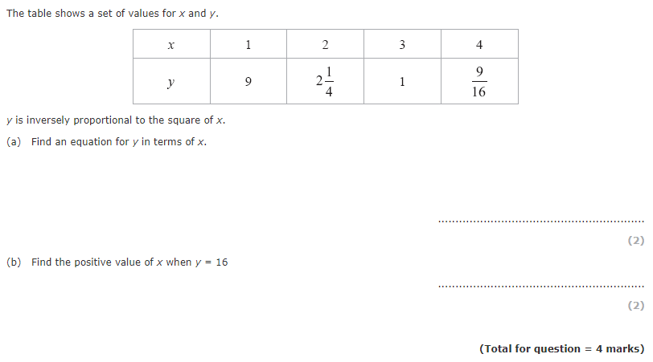
Your Turn
[Edexcel 1MA1/1H, June 2017, Q13]

Slide 34
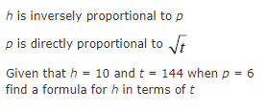
More than two variables…
[Edexcel 1MA1/1H, June 2017, Q13]

Slide 35
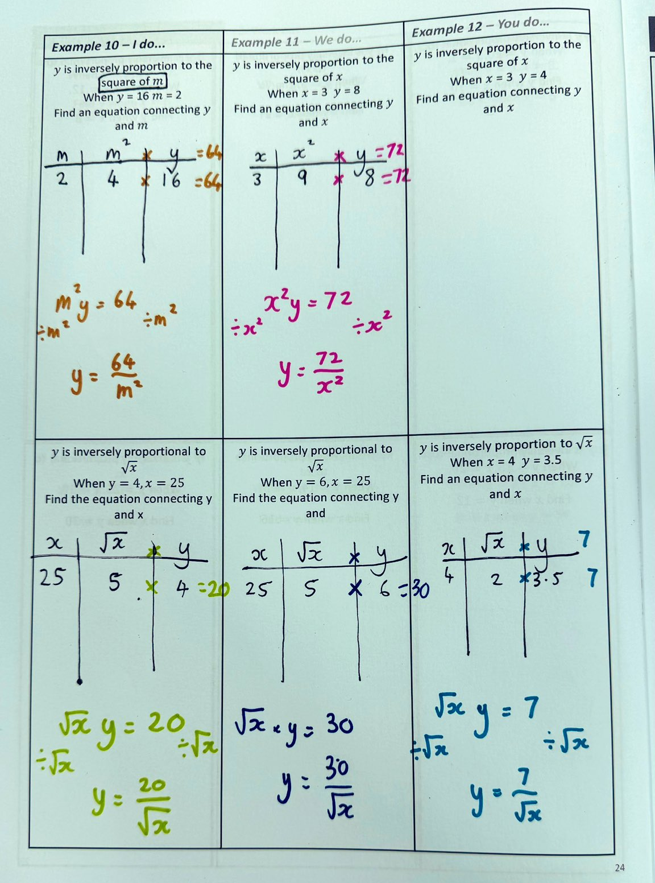
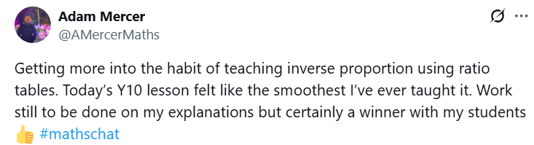
In the wild…
ADD ADAM’S TWEETS

Slide 36
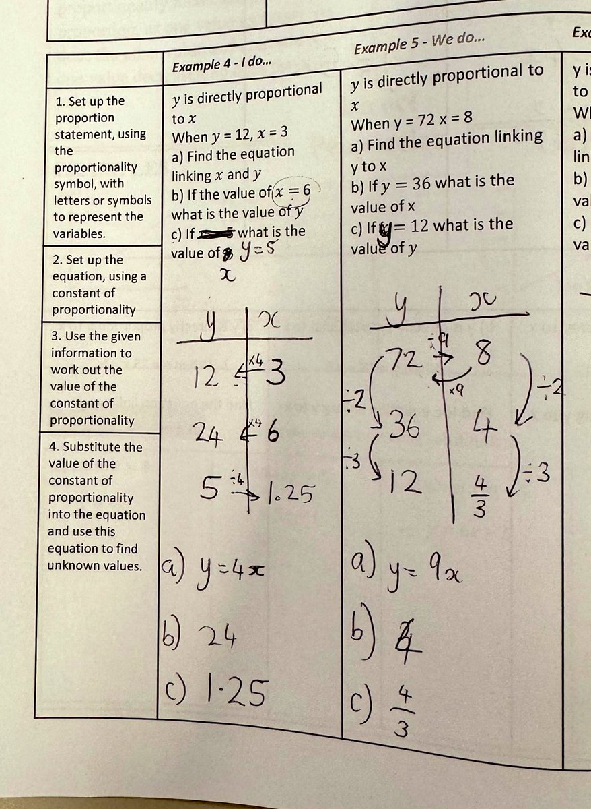
In the wild…
ADD ADAM’S TWEETS

Slide 37
Breaking Up with Formulae:
Ratio Tables are “The One”
Kathryn Clark
Regional Lead practitioner for Maths (South Yorkshire),
AsTREA ACADEMIES TRUST
Arithmaticks@GMAIL.COM
@Arithmaticks @Arithmaticks.BSKY.SOCIAL

